Slide 1
Optional Lessons
Module 10

Slide 3
Learning Units covered in this Module
Extra: Test Storage Subsystem with Diskspd
Extra: Partitioned Tables and Indexes
Extra: Columnstore Indexes
Extra: In-Memory OLTP Tables
Extra: Intelligent Query Processing
Extra: Resource Governor

Slide 4
Extra: Test Storage Subsystem with Diskspd

Slide 5

Objectives
After completing this learning, you will be able to:
Use tools to test the storage subsystem for SQL Server.

Slide 6
DiskSpd utility
Storage performance tool
Highly customizable I/O load generator tool
Generate a wide variety of disk request patterns for use in analyzing and diagnosing storage performance issues.
Simulates SQL Server I/O activity, with detailed XML output for result analysis.
Storage performance tests against:
files
partitions
physical disks.
Notes:
The DiskSpd Storage Performance Tool
DiskSpd is a highly customizable I/O load generator tool that can be used to run storage performance tests against files, partitions, or physical disks. DiskSpd can generate a wide variety of disk request patterns for use in analyzing and diagnosing storage performance issues without running a full end-to-end workload. You can simulate SQL Server I/O activity or more complex, changing access patterns, returning detailed XML output for use in automated results analysis.
Vision for the DiskSpd tool
The DiskSpd tool provides the functionality needed to generate a wide variety of disk request patterns, helpful in diagnosis and analysis of storage-based performance issues. For example, it can be used to simulate SQL Server I/O activity and more complex patterns of access which change over time. It enables the user to analyze storage performance without running a full end-to-end workload.
DiskSpd presents results in both a text summary and also a detailed XML form suitable for automated result analysis.
Microsoft/diskspd
From <https://github.com/Microsoft/diskspd/wiki>

Slide 7
SQL Server disk usage patterns
R/W% | Type | Block | Threads / Queue | Simulates
80/20 | Random | 8K | # cores / Files | Typical OLTP data files
0/100 | Sequential | 60K | 1/32 | Transaction Log
100/0 | Sequential | 512K | 1/16 | Table Scans
0/100 | Sequential | 256K | 1/16 | Bulk load
100/0 | Sequential | 1MB | 1/32 | Backup
0/100 | Random | 64K-256K | # cores / Files | Checkpoints

Slide 8
Customizing tests for SQL Server
Parameter | Description
-c<size> | Create files of the specified size.
-d<seconds> | Duration
-f<rst> | Set random or sequential access hints.
-b<size> | The block size used for I/O operations.
-r<alignment> | turns on random I/O access.
-s[i]<size> | Sequential I/O parameter.
-w<percentage> | Perform a write test.
-F<count> | Total number of threads.
-t<count> | Number of threads per target.
-o<count> | Number of outstanding I/O requests per-target per-thread.
-Sh | Disable both software caching and hardware write caching.
-L | Measure latency statistics.
Notes:
Command line and parameters
From <https://github.com/Microsoft/diskspd/wiki/Command-line-and-parameters>

Slide 9
Sample command lines
Review disk performance for sequential IO operations (TransactionLog)
diskspd.exe -c50G -d20 –si –w100 –t8 –o8 –b60K -Sh -L F:\testfile.dat
Review disk performance for random IO operations (OLTP)
diskspd.exe -c50G -d20 -r –w80 –t8 –o8 -b64K -Sh -L F:\testfile.dat
Review disk performance for sequential IO operations (Table Scan)
diskspd.exe -c50G -d20 –si –w0 –t8 –o8 –b512K -Sh -L F:\testfile.dat

Slide 10
Analyzing test results
DiskSpd provides per-thread per-target statistics on data read and written by each thread in terms of:
Advanced sets of statistics which DiskSpd can optionally collect:
Total bytes
Bandwidth
IOPs
Latency
IOPs statistics
Notes:
On completion, DiskSpd will provide a description of the test and a set of results. By default, this will be a human-readable text summary which can also be explicitly specified as -Rtext. An XML summary can be requested with -Rxml. The XML summary also contains a summary of the system configuration (processor topology, run start time, DiskSpd version) and the full configuration of the test in an XML format. The XML summary can then be used to convert command line parameters to their XML equivalents and subsequently passed to the -X parameter.
DiskSpd provides per-thread per-target statistics on data read and written by each thread in terms of total bytes, bandwidth and IOPs. In addition, any requested NT Kernel Logger events and a per-processor CPU utilization summary are also provided.
There are two more advanced sets of statistics which DiskSpd can optionally collect:
latency, specified with the -L parameter
IOPs statistics, specified with the -D parameter
Analyzing test results
From <https://github.com/Microsoft/diskspd/wiki/Analyzing-test-results>

Slide 11

Demonstration
Executing DiskSpd and analyzing output
Notes:
Previous demonstration files are under E:\Archived.
You can open all the demonstrations by using the solutions file :
E:\Demos\SQL_PTO_Optional_Demos.ssmssln
Individual SQL demo file.
E:\Demos\Test Storage Subsystem with Diskspd\M02L02_DiskSpd_examples.ps1
Run the different commands and analyze the results.

Slide 12
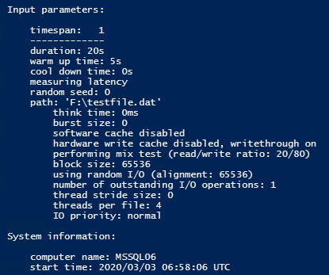
Execute DiskSpd and review the reports
Review the input parameters for a given command line
diskspd.exe -c50G -d20 -r -w80 -t4 -o1 -b64K -Sh -L F:\testfile.dat

Slide 13
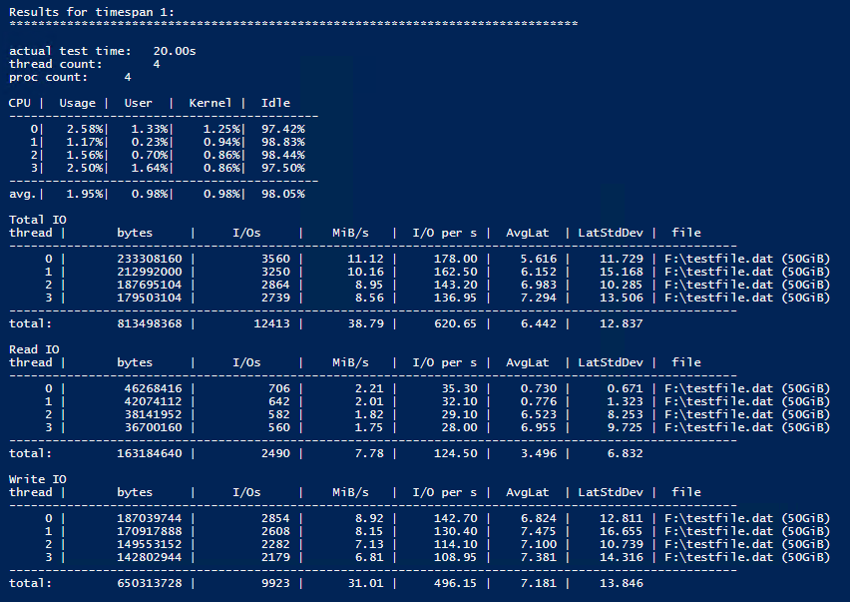
Execute DiskSpd and review the reports
The first section show the CPU usage
The second section show the IO usage, total, per reads and writes.
Example during the time frame of 20 seconds the subsystem completes 12,413 IOPS, 39.79 MB/sec of average throughput and 6.442 milliseconds of average latency

Slide 14
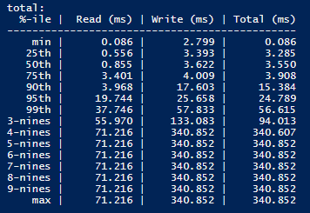
Execute DiskSpd and review the reports
Latency is gathered in per-thread per-target histograms at high precision. In the output, this results in per-thread per-target per-operation-type average latency along with a summary table of per percentile latencies as in the following example:
The data which produced this sample consisted of 12413 I/Os of which 80% were writes (9923) and 20% reads (2490).
In the case of the 99.9th percentile for writes, only 9923 * (1 - 0.999) = ~10 write operations are between its 133.083 ms and the maximum 340.852 ms.
As a result, the 99.99th (4-nines) percentile and onward are the same as the maximum since there is not enough data to differentiate them.

Slide 15
SQLIOSim
Utility tool to perform reliability and integrity tests on disk subsystems.
These tests simulate read, write, checkpoint, backup, sort, and read-ahead activities for Microsoft SQL Server.
Used to test the I/O stability, not performance characteristics.
To perform benchmark tests and determine the I/O capacity of storage system use Diskspd tool.
Notes:
Note: To help maintain appropriate data integrity and security, we recommend that you perform stress tests of your I/O subsystem before you deploy SQL Server on new hardware. The SQLIOSim utility simulates the read patterns, the write patterns, and the problem identification techniques of SQL Server. To perform these tasks, the SQLIOSim utility simulates the user activity and the system activity of a SQL Server system. The SQLIOSim utility performs this simulation independent of the SQL Server engine.
SQLIOSim is designed to generate exactly the same type and patterns of IO requests at a disk subsystem as SQL Server would, and verify the written data exactly as SQL Server would.
Users rarely want to see data that is physically adjacent to data that was just read, and there’s no telling what kind of query might show up from a novice user in a decision support scenario. SQLIOSim can replicate these kinds of requests, and via use of a config file you can tune just how random the requests should be.
How to use the SQLIOSim utility to simulate SQL Server activity on a disk subsystem
From <https://support.microsoft.com/en-us/help/231619/how-to-use-the-sqliosim-utility-to-simulate-sql-server-activity-on-a-d>
SQLIOSim is "NOT" an I/O Performance Tuning Tool
From <https://docs.microsoft.com/en-us/archive/blogs/psssql/sqliosim-is-not-an-io-performance-tuning-tool>

Slide 16
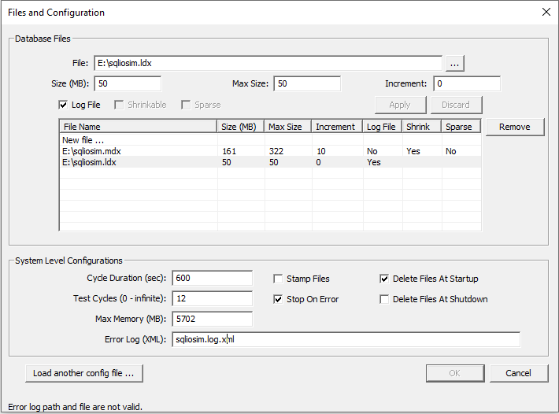
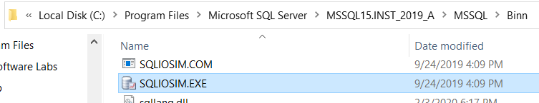
SQLIOSim
SQLIOSim.com and SQLIOSim.exe utilities are found in the BINN folder under
C:\Program Files\Microsoft SQL Server\<instance_name>\MSSQL\BIN:
SQLIOSim.exe is a graphical application.
Notes:
How to use the SQLIOSim utility to simulate SQL Server activity on a disk subsystem:
https://support.microsoft.com/en-us/help/231619/how-to-use-the-sqliosim-utility-to-simulate-sql-server-activity-on-a-d

Slide 17
Demonstration
Executing SQLIOSim and analyzing output
Notes:
Open SQLIOSim.exe from the BINN folder for the SQL Server instance configure a set of files and run the test.
How to use the SQLIOSim utility to simulate SQL Server activity on a disk subsystem
https://support.microsoft.com/en-us/help/231619/how-to-use-the-sqliosim-utility-to-simulate-sql-server-activity-on-a-d

Slide 18
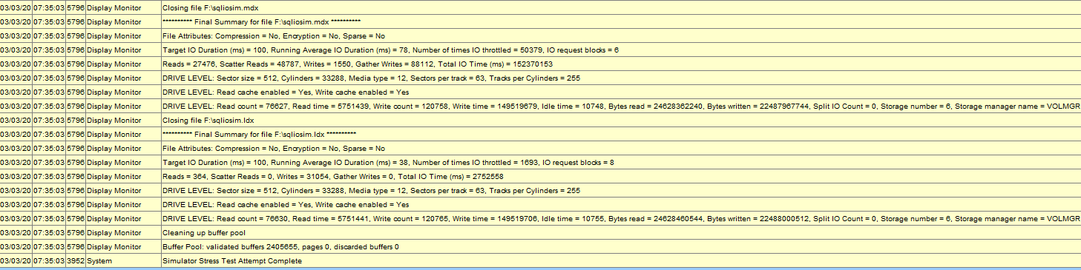
Execute SQLIOSim and review the reports
Look for errors during the execution of the simulator.
Review the results after to stop the simulation
Notes:
Demonstration key points
How It Works: SQLIOSim - Running Average, Target Duration, Discarded Buffers ...
From <https://techcommunity.microsoft.com/t5/sql-server-support/how-it-works-sqliosim-running-average-target-duration-discarded/ba-p/315599>

Slide 19
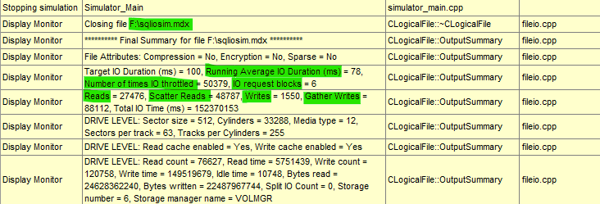
Execute SQLIOSim and review the reports
Review the metrics reported for the simulation
Notes:
How It Works: SQLIOSim - Running Average, Target Duration, Discarded Buffers ...
From <https://techcommunity.microsoft.com/t5/sql-server-support/how-it-works-sqliosim-running-average-target-duration-discarded/ba-p/315599>
Running Average IO Duration (ms) The Running Average IO Duration is response time in Milliseconds that was noticed during the life of the stress test.
If the duration of any IO exceeds 15 seconds, a warning is printed. The running average is not exactly what you might think of when you think of average. It is similar to that used in the Checkpoint logic of SQL Server.
Number of times IO throttled The Number of times IO throttled represents the number of times we removed a request because the duration exceeded and the running average IO duration was going above the target IO duration.
IO request blocks The Io Request blocks indicate the number of IO request blocks the logical file has at the time of report (or at the time test ended). The number of IO Request blocks also shows the number of concurrent outstanding IO requests the file had to meet the specified target IO duration.
Reads: The counter that tracks this is m_lReads. This value is initialized to 0 when the logical file is created and is incremented in FPostRead. This counter is incremented each time a request to read a buffer is posted. This counter does not include the Scatter Reads.
Scatter Reads: The counter that tracks this is m_lScatterReads. This value is initialized to 0 when the logical file is created and is incremented in FPostScatterRead. This counter is incremented each time a request to read a buffer is posted. This counter does not include the Non Scatter Reads.
Writes: The counter that tracks this is m_lWrites. This value is initialized to 0 when the logical file is created and is incremented in FPostWrite. This counter is incremented each time a request to write a buffer is posted. This counter does not include the Gather Writes.
Gather Writes: The counter that tracks this is m_lGatherWrites. This value is initialized to 0 when the logical file is created and is incremented in FPostGatherWrite. This counter is incremented each time a request to read a buffer is posted. This counter does not include the Non Gather Writes.
Total IO Time (ms): The total IO Time shows the cumulative time taken by all IO operations on the file. If we divide the Total IO Time with the total number of IOs(reads+writes_scatterreads+gatherwrites) we will get the traditional average (sum/total) type average over the period of the whole test where as the Running Average IO Duration is only for the last 32 requests as discussed in previous sections.
Validation
The following message is logged when the buffer pool is shutdown.
Buffer Pool: validated buffers 327317, pages 438912, discarded buffers 375356
Validated buffers: The buffer pool for SQLIOSim is similar to that in the SQL Server proper. Each 8K page in memory has an overhead structure (BUF) that has the status and other tracking information. These are also the used as part of the hashing mechanisms. Validating a buffer means that the buffer status matches the page. For example the page number in the buffer matches that on the page. Commonly seen in SQL Server as a 605 error when a mismatch is detected.
Validated pages: This is the number of data pages that have been validated for correct content during read IO completion. The checksum and other checks are performed in much the same way that SQL Server checks for 823 error conditions.
Discarded buffers: These are the number of buffers that have been removed from the buffer pool but are not validated and were not directly dirtied. This can occur as part of a read ahead, just like it does in SQL and I outline in my I/O whitepapers. Say we want to read in pages 1, 2 and 3. However, page 2 is already in the buffer pool. We don't issue 2 I/Os. Instead we issue a single I/O for pages 1, 2 and 3 but we immediately discard page 2. This is a very good counter because it shows the original test that SQLIOStress was designed for - Stale Reads from hardware cache.

Slide 20

DiskSpd
Using DiskSpd to obtain storage performance metric
Notes:
M02L02Lab01

Slide 21

Questions?

Slide 22
Knowledge Check
What tool should be used to perform benchmark tests and determine I/O capacity of the storage system?
What tool should you use if you have to perform reliability and integrity tests on disk subsystems?
Notes:
What tool should be used to perform benchmark tests and determine I/O capacity of the storage system?
DiskSpd
What tool should you use if you have to perform reliability and integrity tests on disk subsystems?
SQLIOSim

Slide 23
Extra: Partitioned Tables and Indexes

Slide 24
Objectives
After completing this learning, you will be able to:
Understand Partition Concepts.
Explain benefits of partitioning.
Distinguish between aligned vs non-aligned indexes.
Manage partitions.
Apply Partition performance guidelines.

Slide 25
What is Partitioning?
“Horizontal Partition”
Table or Index Partition
Breaking a single table or index into multiple HoBT ( Heap or B-Tree) structures
Requires a single column to use as partition key
Partitioning is transparent to all queries
Notes:
Key Points:
Vertical partitions are created manually by segments columns into multiple tables containing a subset of the columns from the original table
you can improve performance by enabling lock escalation at the partition level instead of a whole table.
Per-Partition management options : Index Maintenance ,Lock Escalation, Compression
=============
More Information
=============
Taking Advantage of Multiple Disk Drives
It may be tempting to map your partitions to filegroups, each accessing a different physical disk drive, in order to improve I/O performance. When SQL Server performs data sorting for I/O operations, it sorts the data first by partition. Under this scenario, SQL Server accesses one drive at a time, and this might reduce performance. A better solution in terms of performance is to stripe the data files of your partitions across more than one disk by setting up a RAID. In this way, although SQL Server still sorts data by partition, it can access all the drives of each partition at the same time. This configuration can be designed regardless of whether all partitions are in one filegroup or multiple filegroups.
For more information about how SQL Server works with different RAID levels, Controlling Lock Escalation Behavior
Partitioning tables can improve performance by enabling lock escalation to a single partition instead of a whole table. To reduce lock contention by allowing lock escalation to the partition, use the LOCK_ESCALATION option of the ALTER TABLE statement.
References
http://msdn.microsoft.com/en-us/library/ms177411(v=SQL.105).aspx
https://docs.microsoft.com/en-us/sql/relational-databases/partitions/partitioned-tables-and-indexes

Slide 26
Partitioning benefits
Data Access
Faster data load and offload.
Query performance may be improved:
Piecemeal backup / restore of data by partition.
Per-Partition management available for:
Index Maintenance
when predicate uses Partition-Key → partition elimination
when predicate doesn’t use partition key → parallel execution
Maintenance and management
Data placement handled by SQL Server.
Lock Escalation
Compression

Slide 27
Horizontal Partitioning
Table without
Partition
ProductKey | OrderDateKey | CustomerKey | SalesOrderNumber | UnitPrice | ExtendedAmount | ProductStandardCost
312 | 20050922 | 28191 | SO44236 | 3578.27 | 3578.27 | 2171.2942
313 | 20050923 | 28163 | SO44242 | 3578.27 | 3578.27 | 2171.2942
314 | 20050926 | 28142 | SO44254 | 3578.27 | 3578.27 | 2171.2942
312 | 20050927 | 28171 | SO44259 | 3578.27 | 3578.27 | 2171.2942
Partition Key
Range for Partition 1
Partition 1
ProductKey | OrderDateKey | CustomerKey | SalesOrderNumber | UnitPrice | ExtendedAmount | ProductStandardCost
312 | 20050922 | 28191 | SO44236 | 3578.27 | 3578.27 | 2171.2942
313 | 20050923 | 28163 | SO44242 | 3578.27 | 3578.27 | 2171.2942
Table with Partition
Range for Partition 2
Partition 2
ProductKey | OrderDateKey | CustomerKey | SalesOrderNumber | UnitPrice | ExtendedAmount | ProductStandardCost
314 | 20050926 | 28142 | SO44254 | 3578.27 | 3578.27 | 2171.2942
312 | 20050927 | 28171 | SO44259 | 3578.27 | 3578.27 | 2171.2942

Slide 28
Table Partitioning Concepts
Partition Function
Defines how the table is logically partitioned.
Defines data type of partition key, and ranges of each partition.
Ranges can be modified as needed.
Partition Schemes
Specify mapping from partitioned table to Filegroup(s).
Uses Partition Function to perform mapping.
Partition Table & index
Partitioned Tables are defined using Partition Schemes.
Several tables may share common Partition Functions and Partition Schemes.
Loading data into the table or index creation, will move data to correct partition automatically.
Partition Column (key)
Column used to apply partition function.
If using a computed column, it must be explicitly marked as PERSISTED.
Different filegroups can provide increased performance, but is not required.
Notes:
Key Points:
Partition Function
Ranges of each partition can either be Range Right vs. Range Left.
Partition ranges can be modified over the time, but Partition Function data type cannot be modified.
Number of partitions = number of boundary values + 1.
A boundary value can exist in only one partition.
Range LEFT means that the boundary value falls into the left partition. Right means it falls into the right partition.
Partition Schemes
Associates each partition defined by a partition function with a storage location (Filegroup).
No requirement to use different filegroups for different partitions.
BUT using different filegroups is useful for filegroup-based backup or storage location.
Best Practice: Spread all Filegroups in a Partition Scheme across as many disk spindles as possible.
Partition Table
Data is now automatically partitioned.
Loading the table will distribute the data to its partitions.
Best Practice: When designing partition functions and schemes, plan to keep the rightmost and leftmost FGs empty.

Slide 29
Aligned vs Non-aligned indexes
Aligned Index
An index that is built on the same partition scheme as its corresponding table.
When a table and its indexes Align, SQL Server can switch partitions quickly and efficiently.
Non-aligned index
An index partitioned independently from its corresponding table.
Designing a non-aligned partitioned index can be useful in the following cases:
The base table has not been partitioned.
The index key is unique, and it does not contain the partitioning column of the table.
Useful when want to joins with more tables using different join columns.
Notes:
Aligned index
An index that is built on the same partition scheme as its corresponding table.
When a table and its indexes are in alignment, SQL Server can switch partitions quickly and efficiently while maintaining the partition structure of both the table and its indexes.
An index does not have to participate in the same named partition function to be aligned with its base table.
However, the partition function of the index and the base table must be essentially the same, in that:
The arguments of the partition functions have the same data type.
They define the same number of partitions.
They define the same boundary values for partitions.
Non-aligned index
An index partitioned independently from its corresponding table. That is, the index has a different partition scheme or is placed on a separate filegroup from the base table. Designing a non-aligned partitioned index can be useful in the following cases:
The base table has not been partitioned.
The index key is unique and it does not contain the partitioning column of the table.
You want the base table to participate in collocated joins with more tables using different join columns.
References:
https://docs.microsoft.com/en-us/sql/relational-databases/partitions/partitioned-tables-and-indexes?view=sql-server-ver15

Slide 30
Indexes on Partitioned Table
Indexes are logically aligned when they use partitioning column.
Storage Alignment
By default, indexes will be created ON the partition scheme – ‘storage aligned’ indexes.
Logical Alignment
Indexes are storage aligned when created on the same partitioning scheme.
CREATE [CLUSTERED] INDEX … ON {partition_scheme_name ( column_name ) }
Notes:
Partitioning Clustered Indexes
When partitioning a clustered index, the clustering key must contain the partitioning column.
When partitioning a nonunique clustered index, and the partitioning column is not explicitly specified in the clustering key, SQL Server adds the partitioning column by default to the list of clustered index keys.
If the clustered index is unique, you must explicitly specify that the clustered index key contain the partitioning column.
By default, indexes will be created ON the partition scheme – “storage aligned” indexes:
Each index’s partition is stored on the same filegroup as its partition.
Important to do this if you plan on altering the partition function.
Partitioning NonClustered Indexes
When partitioning a unique nonclustered index, the index key must contain the partitioning column.
When partitioning a nonunique, nonclustered index, SQL Server adds the partitioning column by default as a non-key (included) column of the index to make sure the index is aligned with the base table.
SQL Server does not add the partitioning column to the index if it is already present in the index.

Slide 31
Partitioned table and index sample
-- Creating a partition function with four partitions
CREATE PARTITION FUNCTION myRangePF1 (int)
AS RANGE LEFT FOR VALUES (1, 100, 1000) ;
GO
-- Creates a partition scheme that applies myRangePF1 to the four filegroups
CREATE PARTITION SCHEME myRangePS1
AS PARTITION myRangePF1
TO (test1fg, test2fg, test3fg, test4fg) ;
GO
-- Creates a partitioned table that uses myRangePS1 to partition col1
CREATE TABLE PartitionTable (col1 int NOT NULL, col2 char(10))
ON myRangePS1 (col1) ;
GO
CREATE CLUSTERED INDEX ClusIndxCol1 ON PartitionTable(col1)
ON myRangePS1(col1)
GO
Notes:
References
https://docs.microsoft.com/en-us/sql/relational-databases/partitions/create-partitioned-tables-and-indexes?view=sql-server-ver15

Slide 32
Table Partitioning Operations
Data Movement in table or Partition is done using ALTER …SWITCH/MERGE/SPLIT
SWITCH
Uses staging table
MERGE
Used to eliminate an empty partition, by merging it with another partition
SPLIT
Used to create a new empty partition from an existing partition
MUST have same schema as Partitioned table
--SWITCH
ALTER TABLE PartitionTable SWITCH PARTITION 2 TO NonPartitionTable ;
--SPLIT
CREATE PARTITION FUNCTION myRangePF1 (int) AS RANGE LEFT FOR VALUES ( 1, 100, 1000 );
ALTER PARTITION FUNCTION myRangePF1() SPLIT RANGE (500);
--MERGE
CREATE PARTITION FUNCTION myRangePF1 (int) AS RANGE LEFT FOR VALUES ( 1, 100, 1000 );
ALTER PARTITION FUNCTION myRangePF1() MERGE RANGE (100);
Notes:
Key Notes:
SWITCH Requirements
There are numerous requirements for the SWITCH command.
For example,
The switched tables must have the same column structure and indexes, even the same foreign key constraints.
Source and target tables must share the same filegroup.
The target/receiving table (or partition) must be empty.
=============
More Information
=============
General Requirements for Switching Partitions
When a partition is transferred, the data is not physically moved; only the metadata about the location of the data changes. Before you can switch partitions, several general requirements must be met:
Both tables must exist before the SWITCH operation.
The table from which the partition is being moved (the source table) and the table that is receiving the partition (the target table) must exist in the database before you perform the switch operation.
The receiving partition must exist, and it must be empty.
Whether you are adding a table as a partition to an already existing partitioned table, or moving a partition from one partitioned table to another, the partition that receives the new partition must exist and it must be an empty partition.
The receiving nonpartitioned table must exist and it must be empty.
If you are reassigning a partition to form one nonpartitioned table, the table that receives the new partition must exist and it must be an empty nonpartitioned table.
Partitions must be on the same column.
If you are switching a partition from one partitioned table to another, both tables must be partitioned on the same column.
Source and target tables must share the same filegroup.
The source and the target table of the ALTER TABLE...SWITCH statement must reside in the same filegroup, and their large-value columns must be stored in the same filegroup. Any corresponding indexes, index partitions, or indexed view partitions must also reside in the same filegroup. However, the filegroup can be different from that of the corresponding tables or other corresponding indexes.
Source and target tables must not be replicated.
Neither the source table nor the target table can be sources of replication.
Triggers must not activate while moving partitions.
No INSERT, UPDATE, or DELETE triggers or cascading actions are activated by moving table partitions, and it is not required for the source or target tables to have similarly defined triggers to move partitions.
References:
SPLIT/MERGE Best Practices
Always keep empty partitions at both ends of the partition range.
Keep the partitions at both ends to guarantee that the partition split and the partition merge don't incur any data movement.
The partition split occurs at the beginning and the partition merge occurs at the end.
Avoid splitting or merging populated partitions.
Splitting or merging populated partitions can be inefficient.
They can be inefficient because the split or merge may cause as much as four times more log generation and may also cause severe locking.
References:
https://docs.microsoft.com/en-us/previous-versions/sql/sql-server-2008-r2/ms191160(v=sql.105)
https://docs.microsoft.com/en-us/sql/t-sql/statements/alter-table-transact-sql?view=sql-server-ver15
https://docs.microsoft.com/en-us/sql/t-sql/statements/alter-partition-function-transact-sql?view=sql-server-ver15

Slide 33
Demonstration
Partitioning
Explore Partition Schemes and Functions.
Notes:
Previous demonstration files are under E:\Archived.
You can open all the demonstrations by using the solutions file :
E:\Demos\SQL_PTO_Optional_Demos.ssmssln
Individual SQL demo file.
E:\Demos\Partitioned Tables and Indexes\PartitionTable.sql

Slide 34
SQL Server Partitioning
Practicing with a sliding partition window
Notes:
M05L03Lab01
Link to lab: Use electronic material to complete the lab exercise “Sliding Partition”

Slide 35
Questions?

Slide 36
Knowledge Check
What three structures are required to support partitions?
What are some benefits of partitioning?
What is used for data movement in partitions or table?
Notes:
Answer 1:
Partition schemes, partition functions and partition column
Answer 2:
Simplified data movement. With partition switches, data can be loaded into and out of tables easily. In addition, query performance can be improved when queries can eliminate partitions from consideration.
Answer 3:
Switch, Split, and Merge

Slide 37
Extra: Columnstore Indexes

Slide 38
Objectives
After completing this learning, you will be able to:
Understand the differences between rowstore and Columnstore indexes.
Understand the primary use case for Columnstore indexes.
Examine and monitor Columnstore indexes.

Slide 39
Rowstore INDEX design
Up to 1,000 indexes per table
Up to 16 columns for index key
900 bytes per clustered index
1700 bytes per non-clustered index
Regular types of indexes (Cluster/NonClustered) wouldn’t be able to handle the workload.
It will be impractical to create indexes on all individual columns, or to create all possible column combinations.

Slide 40
Traditional Storage Models
Retrieving data from few columns require all rows to be read, or having indexes designed for specific queries (Key + Included Columns).
…
Notes:
In a traditional SQL table, data can be stored in either a heap (no clustered index) or a B-Tree. The values comprising one row are stored contiguously on a page which means all columns for a row are stored on the same page. We sometimes refer to data stored in row-wise fashion as a row store.

Slide 41
Why Columnstore indexes?
Clustered Index
Use to store fact tables and large dimension tables for data warehousing workloads.
This method improves query performance and data compression by up to 10 times.
Non-Clustered Index
Use to perform analysis in real time on an OLTP workload.
Notes:
Columnstore indexes for data warehousing.
Get started with columnstore for real-time operational analytics.

Slide 42
Why should I use a Columnstore index?
Columns store values from the same domain and commonly have similar values, which result in high compression rates. I/O bottlenecks in your system are minimized or eliminated, and memory footprint is reduced significantly.
High compression rates improve query performance by using a smaller in-memory footprint. In turn, query performance can improve because SQL Server can perform more query and data operations in memory.
Batch execution improves query performance, typically by two to four times, by processing multiple rows together.
Queries often select only a few columns from a table, which reduces total I/O from the physical media.

Slide 43
Columnstore Index Storage Model
C1
C2
C3
C4
C5
C6
Each page stores data from a single column
Highly compressed
More data fits in memory
Each column can be accessed independently
Fetch only columns that are needed
Can dramatically decrease I/O
Notes:
When data is stored in column-wise fashion, the data can often be compressed more effectively than when stored in row-wise fashion. Typically there is more redundancy within a column than within a row, which usually means the data can be compressed to a greater degree. When data is more compressed, less IO is required to fetch the data into memory. In addition, a larger fraction of the data can reside in a given size of memory. Reducing IO can significantly speed up query response time. Retaining more of your working set of data in memory will speed up response time for subsequent queries that access the same data.
When data is stored column-wise, it is possible to access the column individually. If a query only references a few of the columns in the table, it is only necessary for a subset of the columns to be fetched from disk into memory. For example, if a query references five columns from a table with 50 columns (i.e. 10% of the columns), IO is reduced by 90% (in addition to any benefits from compression).
On the other hand, storing columns in independent structures means that the data must be recombined to return the data as a row. When a query touches only one (or a few) rows, having all the data for one row stored together can be an advantage if the row can be quickly located with a B-tree index. Row stores may offer better query performance for very selective queries, such as queries that lookup a single row or a small range of rows. Updating data is also simpler in a row store.

Slide 44
Row Groups & Segments
Segments
C1
C2
C3
C4
C5
C6
Segment
Contains values for one column for a set of rows.
Segments are compressed.
Each segment is stored in a separate LOB.
It is a unit of transfer between disk and memory.
Row Group
Segments for the same set of rows
comprise a row group.
Position of a value in a column indicates to which
row it belongs to.
Row group
Notes:
For high performance and high compression rates, the columnstore index slices the table into groups of rows, called row groups, and then compresses each row group in a column-wise manner. The number of rows in the row group must be large enough to improve compression rates, and small enough to benefit from in-memory operations.
A rowgroup is a group of rows that are compressed into columnstore format at the same time.
A column segment is a column of data from within the rowgroup.
Each rowgroup contains one column segment for every column in the table.
Each column segment is compressed together and stored on physical media.

Slide 45
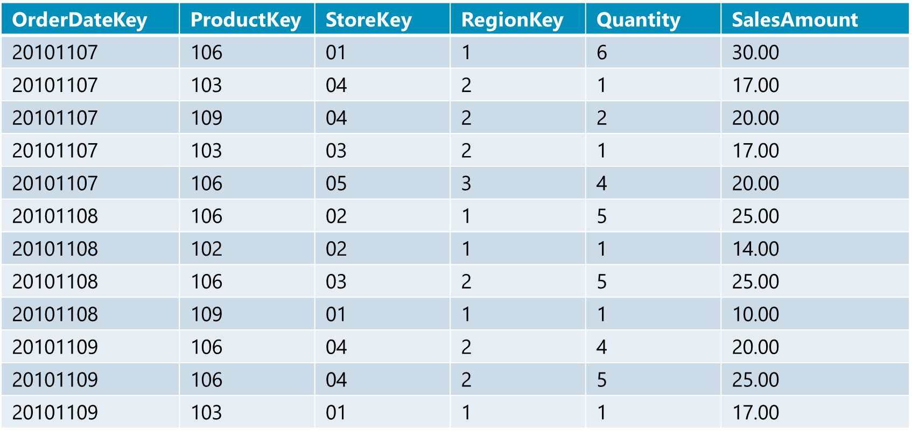
Columnstore Index Processing Example
Notes:
The columnstore index itself stores data in highly compressed format, with each column kept in a separate group of pages. This greatly reduces I/O for most data warehouse queries because many data warehouse fact tables contain 30 or more columns, while a typical query might touch only 5 or 6 columns. Only the columns touched by the query must be read from disk. Only the more frequently accessed columns have to take up space in main memory. The clustered B-tree or heap containing the primary copy of the data is normally used only to build the columnstore, and will typically not be accessed for the large majority of query processing. It'll be paged out of memory and won't take main memory resources during normal periods of query processing.

Slide 46
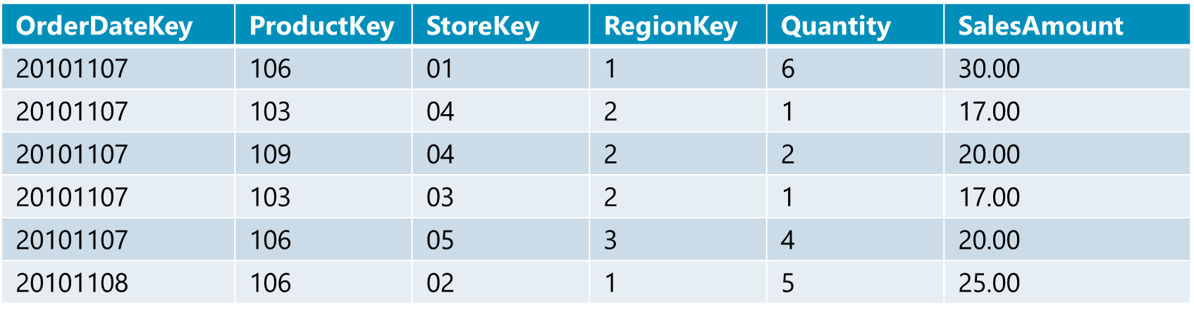
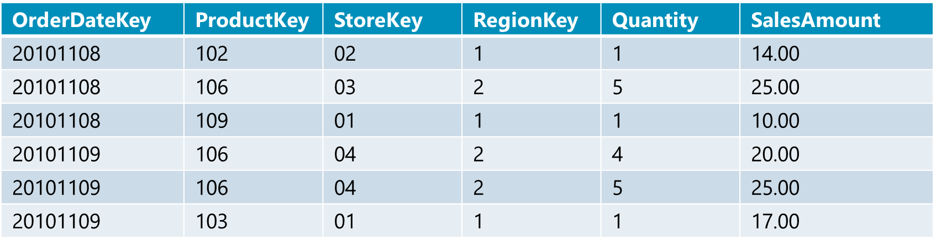
Horizontally Partition - Row Groups
~ 1M
rows
Number of rows per RowGroup is calculated as high as possible to get good compression rate, but low enough to not use too much memory
Table is sliced in Group of Rows, called RowGroups
RowGroups are compressed in column-wise manner
Notes:
For high performance and high compression rates, the columnstore index slices the table into groups of rows, called row groups, and then compresses each row group in a column-wise manner. The number of rows in the rowgroup must be large enough to improve compression rates, and small enough to benefit from in-memory operations. Generally we try to maintain a rowgroup at approximately 1 million rows but there are reasons why a rowgroup can be smaller than that target size which will be explained later.
A rowgroup is a group of rows that are compressed into columnstore format at the same time.

Slide 47
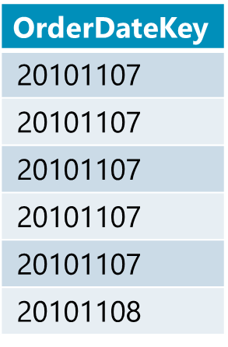
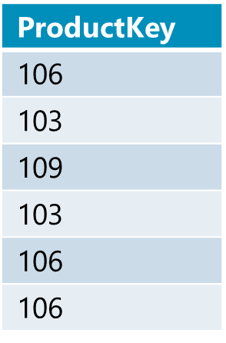
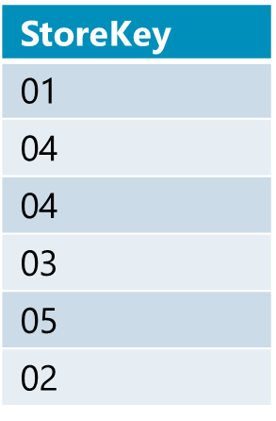
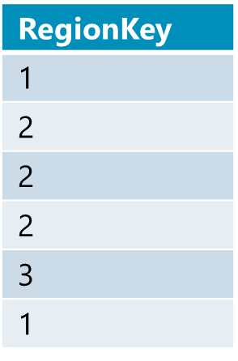
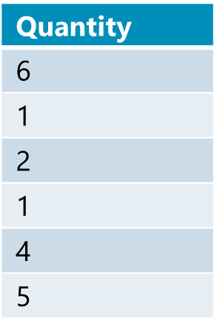
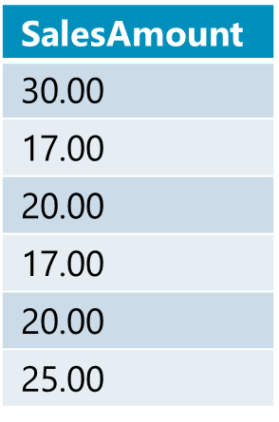
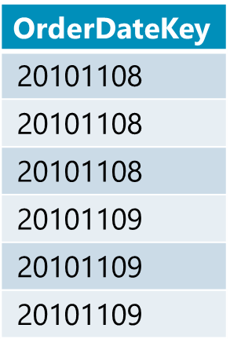
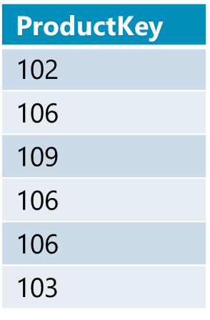
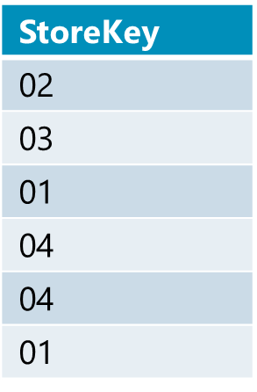
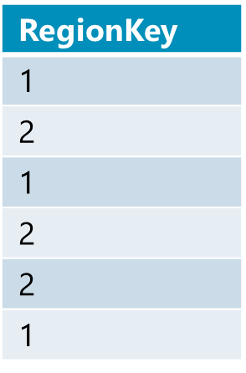
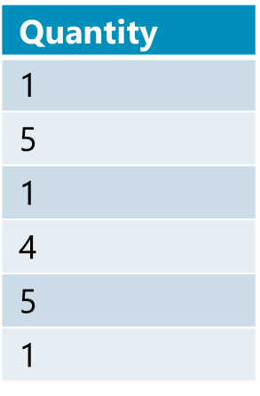
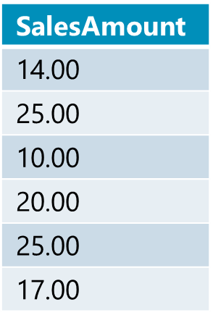
Vertical Partition - Segments
Notes:
A column segment is a column of data from within the rowgroup.
A rowgroup usually contains the maximum number of rows per rowgroup which is 1,048,576 rows.
Each rowgroup contains one column segment for every column in the table per partition (if a partitioned table).
Each column segment is compressed together and stored on physical media.
Each column segment is the unit of transfer from an IO perspective.

Slide 48
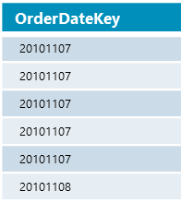
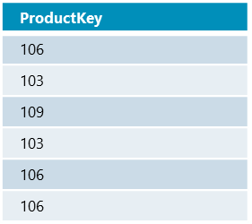
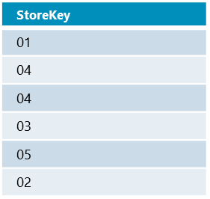
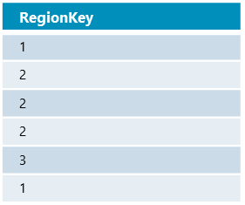
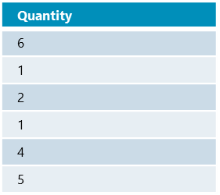
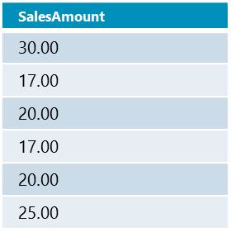
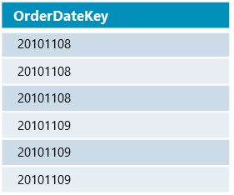

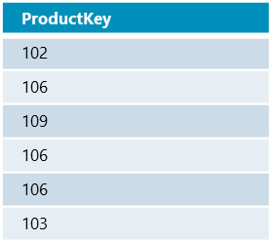
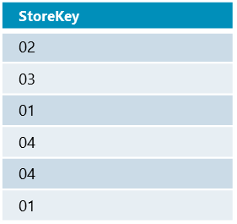
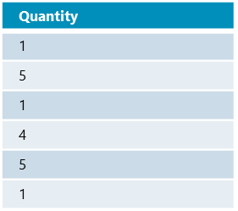
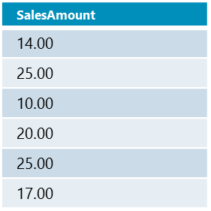
Compress each segmentOthers
*Encoding and reordering not shown
This compression is not the same as Page / Row compression
Segments not necessarily get same compression rate
Notes:
This compression is different from Page or Row compression on a row based table. Of importance is the visual aspect that the boxes are different sizes and shapes. That is because you don’t get the same compression necessarily on every segment. Compression is done per segment per partition. This allows partition switching to be a metadata-only operation.
Multiple compression techniques are used including run-length encoding and dictionary encoding.

Slide 49
Delta Store
A b-tree staging area
Rows accumulate until there are enough to be compressed into the columnstore format
1,048,576 rows
A background process compresses these rows to columnstore compression
Allows for efficient access to “warm” data
Improves compression of the columnstore index
Will not see batch mode execution from row store storage
Introduced for clustered columnstore indexes but also exists for updateable non-clustered Columnstore indexes in 2016

Slide 50
Dictionaries
v
v
v
Primary Dictionary
Primary Dictionary
Primary Dictionary
String data encoded per column
Encoded values in segments are bookmarks to dictionary
Primary dictionary is one per partition
Secondary dictionary is 1 or more per segment
Stored as a LOB value as part of the table storage
C1
C2
C3
SecondaryDictionary
SecondaryDictionary
SecondaryDictionary
SecondaryDictionary
SecondaryDictionary
SecondaryDictionary
Notes:
SQL Server column stores use a form of dictionary encoding wherein frequently occurring values are mapped to a 32 bit id via the dictionary. SQL Server uses two forms of dictionaries, a global dictionary associated with the entire column and a local dictionary associated with a row group.
Dictionaries are used to encode some, but not all data types, therefore not all columns in a columnstore index have dictionaries. A dictionary can exist as a primary dictionary (for all segments) and possibly for other secondary dictionaries used for a subset of the column's segments. We will never sort the data within a column segments based on its dictionary.
You can query sys.column_store_dictionaries which contains a row for each dictionary used in xVelocity memory optimized columnstore indexes.
A dictionary type can be assigned the following values:-
1 – Hash dictionary containing int values
2 – Not used
3 – Hash dictionary containing string values
4 – Hash dictionary containing float values

Slide 51
Index Creation and Storage
1) Based table is divided into row groups (1MM each)
2) Row Groups are encoded & compressed
Column Metadata contains information about Rows/Segment; Segment-Size; Data Encode; min & max
Base table
Columnstore index
Compressed
A
B
C
D
column segments
Blobs
Encode
Rowgroup
Rowgroup 1
compress
Segment directory
Rowgroup
Encode
Rowgroup 2
~1M rows/group
compress
Rowgroup
Encode
Rowgroup 3
compress
System table: sys.column_store_segments
Includes segment metadata: size, min, max, …
Notes:
Index creation starts by dividing the base table into row groups of around one million records each. The rows groups are then encoded and compressed independently and create one compressed segment for each column.
Unlike In-Memory OLTP, columnstore makes use of the standard SQL Server storage mechanisms as each column segment is stored in a separate blob. A directory keeps track of all column segments so that segments, which make up a column, can be tracked. The DMV sys.column_store_segments can interrogate this directory to report how many rows, are in each segment, segment size, how data is encoded and the min and max size of each segment. Dictionary compression is used for (large) string columns and the resulting dictionaries are stored in separate blobs.
Logging, recovery, partitioning, mirroring, replication are automatically enabled as we are using existing blob storage without the need for new storage mechanisms.
Segments and dictionaries are brought into the a new cache for handling large objects. Objects are stored continuously which helps speed up scanning of a column. Read-Ahead is applied to both reading the dictionaries and segments.
Please refer to the Columnar Storage in SQL Server 2012 paper at:- http://sites.computer.org/debull/A12mar/apollo.pdf

Slide 52
Memory Requirements
Build/reindex is always parallel unless memory is constrained.
- Can be FORCED with (MAXDOP = 1).
Roughly it takes about 1.5 times as long to create a columnstore index as compared to a b-tree index.
Memory required depends on the number of columns, types of columns, and amount of parallelism involved.
MAXDOP may be adjusted for the build as dictated by the amount of available memory.
Always occurs in batch mode in SQL 2016.

Slide 53
Batch Mode Processing
Process around 1000 rows at a time
As opposed to 1 row at a time with row-based processing
Not all query plan operators can perform batch processing
nested loops
Plan operators are expanded in SQL Server 2016+
Greatly reduced CPU time (7 to 40X)
merge join
Notes:
Batch mode processing uses a new iterator model for processing data a-batch-at-a-time instead of a-row-at-a-time. A batch typically represents about 1000 rows of data. Each column within a batch is stored as a vector in a separate area of memory, so batch mode processing is vector-based. Batch mode processing also uses algorithms that are optimized for the multicore CPUs and increased memory throughput that are found on modern hardware. Batch mode processing spreads metadata access costs and other types of overhead over all the rows in a batch, rather than paying the cost for each row. Batch mode processing operates on compressed data when possible and eliminates some of the exchange operators used by row mode processing. The result is better parallelism and faster performance and greatly reduced CPU time (7 to 40X).
Batch mode processing occurs only for parallel query execution. If the cost of the query plan is small, the optimizer may choose a serial plan that is "good enough." When experimenting with columnstore indexes, you may need a large data set to see the effects of batch mode processing. Check the degree of parallelism if you see that a query was executed in row mode when you expected batch mode.
The other consideration is segment elimination, which results in all but one segment being eliminated, inherently determining that DOP will be 1, as the unit of parallelism is the segment itself.

Slide 54
Segment Elimination
Skips large chunks of data to speed up scans
Each partition in a column store index is broken into segments
Each segment has metadata that stores the minimum and maximum value of each column for the segment
The storage engine checks filter conditions against the metadata
If it detects no rows that qualify, it skips the entire segment without reading it from disk
Notes:
Segment elimination can increase the speed of data retrieval and it is important to understand the basics:
It will skip large chunks of data to speed up scans.
Each partition in a columnstore index is broken into segments.
Each segment has metadata that stores the minimum and maximum value of each column for the segment.
The storage engine checks filter conditions against the metadata.
If it can detect that no rows will qualify, then it skips the entire segment without even reading it from disk.

Slide 55
Segment Elimination
SELECT ProductKey, SUM(SalesAmount)
FROM SalesTable
WHERE OrderDateKey < 20101108;
1. Fetches only needed columns
Not included in the query column list
Notes:
In the example, given the Select statement only references the ProductKey, SalesAmount and the OrderDateKey columns, the remainder of the columns do not get fetched. This is possible as the unit of storage for Columnar indexes is the segment which individually comprises data for a single column.
The columnstore index itself stores data in a highly compressed format, with each column kept in a separate group of pages. This reduces I/O a lot for most data warehouse queries because many data warehouse fact tables contain 30 or more columns, while a typical query might touch only 5 or 6 columns. Only the columns touched by the query must be read from disk. Only the more frequently accessed columns have to take up space in main memory.

Slide 56
Fetch Only Needed Segments
SELECT ProductKey, SUM(SalesAmount)
FROM SalesTable
WHERE OrderDateKey < 20101108;
2. Fetches only needed segments
Not included in the query column list
Outside the range of filter
Notes:
Segment elimination can skip large chunks of data to speed up scans. Each partition in a columnstore indexes is broken into one million row chunks called segments. Each segment has metadata that stores the minimum and maximum value of each column for the segment. The storage engine checks filter conditions against the metadata. If it can detect that no rows qualify, then it skips the entire segment without even reading it from disk.
In the example, the predicate is “OrderDateKey < 20101108”
Using the predicate in the query and the segment metadata, the query processor is able to determine whether an entire segment can be skipped or not thereby saving on IO and CPU time. In the example you visually see that an entire segment is eliminated as the min and max values are outside of the range of the predicate.
On a partitioned table, partition elimination can work in conjunction with segment elimination.

Slide 57
Monitoring Column Store Indexes
sys.column_store_row_groups
sys.column_store_dictionaries
sys.column_store_segments

Slide 58
Demonstration
Column store metadata
Notes:
Previous demonstration files are under E:\Archived.
You can open all the demonstrations by using the solutions file :
E:\Demos\SQL_PTO_Optional_Demos.ssmssln
Individual SQL demo file.
E:\Demos\ColumnStore Indexes\Column Store Index.sql

Slide 59
ColumnStore Index Performance
Measure the performance of rowstore indexes versus colunmstore indexes.
Notes:
M05L04Lab01
Link to lab: Use electronic material to complete the lab exercise “ColumnStore Index Performance”

Slide 60
Questions?

Slide 61
Knowledge Check
Name a primary reason for implementing a column store index?
What is the purpose of segments?
What is the purpose of row groups?
Notes:
To perform aggregate functions on large datasets efficiently. To compress data.
Segments allow the optimizer to have the storage engine eliminate data that is not required to satisfy the query.
Row groups allow for an optimal number of rows for the column store compression algorithm to be processed.

Slide 62
Extra: In-Memory OLTP

Slide 63
Objectives
After completing this learning, you will be able to:
Understand the motivation behind Memory-Optimized objects.
Describe the characteristics of Memory-Optimized objects.
Monitor resources consumed by Memory-Optimized objects.

Slide 64
Drivers for Memory-Optimized objects
With increased hardware capacity (CPU/memory/storage) new method of concurrent data access is required to address:
Performance
Latch Contention
Spinlock Contention
Concurrency
CPU
I/O contention
Scalability
Notes:
Introduction to Memory-Optimized Tables
https://docs.microsoft.com/en-us/sql/relational-databases/in-memory-oltp/introduction-to-memory-optimized-tables?view=sql-server-ver15

Slide 65
Memory-Optimized objects
Recommended use
Use to get:
Increased transaction throughput
Improved data ingestion rate
Reduced latency
Transient data scenarios
Do not use when:
Analytics/BI (consider Columnstore instead)
Bottleneck is outside SQL:
Chatty App
Bottleneck is in the app
Low transaction volume
Resource limitations – not enough memory
No locking
No latching
Notes:
Creating Natively Compiled Stored Procedures
https://docs.microsoft.com/en-us/sql/relational-databases/in-memory-oltp/creating-natively-compiled-stored-procedures?view=sql-server-ver15
The user issues a CREATE PROCEDURE statement to SQL Server.
The parser and algebrizer create the processing flow for the procedure, as well as query trees for the Transact-SQL queries in the stored procedure.
The optimizer creates optimized query execution plans for all the queries in the stored procedure.
The In-Memory OLTP compiler takes the processing flow with the embedded optimized query plans and generates a DLL that contains the machine code for executing the stored procedure.
The generated DLL is loaded into memory.

Slide 66
Memory-Optimized Objects
Object types
Objects
Code
Natively compiled Stored Procedures
Triggers
Tables
Types
Functions
Notes:
https://docs.microsoft.com/en-us/sql/relational-databases/in-memory-oltp/sample-database-for-in-memory-oltp?view=sql-server-ver15
https://docs.microsoft.com/en-us/sql/relational-databases/in-memory-oltp/faster-temp-table-and-table-variable-by-using-memory-optimization?redirectedfrom=MSDN&view=sql-server-ver15
https://docs.microsoft.com/en-us/sql/relational-databases/in-memory-oltp/native-compilation-of-tables-and-stored-procedures?view=sql-server-ver15

Slide 67
Memory-Optimized Objects
Can be accessed via:
Interop T-SQL allows for full range of SQL syntax
Natively compiled Stored Procedures
Transactions involving Memory-Optimized tables are Atomic, Consistent, Isolated, and Durable (ACID)
Primary store for memory-optimized tables is main memory.
All operations on these objects happen in memory.
Support durable tables with Transaction Durability Delayed.
Durable
Non-Durable
Not logged
Data is not persisted on disk.
Second copy of the table is maintained on disk
Notes:
Introduction to Memory-Optimized Tables
https://docs.microsoft.com/en-us/sql/relational-databases/in-memory-oltp/introduction-to-memory-optimized-tables?view=sql-server-ver15

Slide 68
Memory-Optimized structure
Rows
Row structure is optimized for memory access
There is no concept of Pages
Rows are Versioned and there are no in-place updates
Indexes
Every memory-optimized object is required to have at least 1 index
Indexes do not exist on disk. Only in memory. Recreated during recovery / restart
Index types:
Hash indexes for point lookups
Range indexes (non-clustered) for ordered scans and Range Scans
There is no clustered Index
Indexes point to rows, access to rows is via an index
Notes:
Memory-optimized tables are fully durable by default, and, like transactions on (traditional) disk-based tables, fully durable transactions on memory-optimized tables are fully atomic, consistent, isolated, and durable (ACID). Memory-optimized tables and natively compiled stored procedures support a subset of Transact-SQL. SQL Server features are supported to meet the requirements of OLTP applications that require optimal performance.
The primary store for memory-optimized tables is main memory; memory-optimized tables reside in memory. Rows in the table are read from and written to memory. The entire table resides in memory. A second copy of the table data is maintained on disk, but only for durability purposes. Data in memory-optimized tables is only read from disk during database recovery. For example, after a server restart.
Rows in memory-optimized tables are versioned. This means that each row in the table potentially has multiple versions. All row versions are maintained in the same table data structure. Row versioning is used to allow concurrent reads and writes on the same row.
Indexes on memory-optimized tables are not stored as traditional B-trees. Memory-optimized tables support hash indexes, stored as hash tables with linked lists connecting all the rows that hash to the same value and range indexes, which for memory-optimized tables are stored using special Bw-trees.
Every memory-optimized table must have at least one index, because it is the indexes that combine all the rows into a single table. Memory-optimized tables are never stored as unorganized sets of rows, like a disk-based table heap is stored.
Indexes are never stored on disk, and are not reflected in the on-disk checkpoint files, and operations on indexes are never logged. The indexes are maintained automatically during all modification operations on memory-optimized tables, just like B-tree indexes on disk-based tables. But in case of a SQL Server restart, the indexes on the memory-optimized tables are rebuilt as the data is streamed into memory.

Slide 69
Memory-Optimized
Hash Index
BUCKET_COUNT 1-2X nr of unique index key values actual count is the next integer power of 2
Create Table DDL
CREATE TABLE [Customer](
[CustomerID] INT NOT NULL
PRIMARY KEY NONCLUSTERED HASH WITH (BUCKET_COUNT = 1000000),
[Name] NVARCHAR(250) NOT NULL,
[CustomerSince] DATETIME NULL
INDEX [ICustomerSince] NONCLUSTERED
)
WITH (MEMORY_OPTIMIZED = ON, DURABILITY = SCHEMA_AND_DATA);
Indexes are specified inline
This table is memory optimized
This table is durable
Non-durable tables:
DURABILITY=SCHEMA_ONLY

Slide 70
Memory-Optimized
Create Stored Procedure DDL
CREATE PROCEDURE [dbo].[InsertOrder] @id INT, @date DATETIME
WITH
NATIVE_COMPILATION,
SCHEMABINDING,
EXECUTE AS OWNER
AS
BEGIN ATOMIC
WITH
(TRANSACTION
ISOLATION LEVEL = SNAPSHOT,
LANGUAGE = N'us_english')
-- insert T-SQL here
END
This proc is natively compiled
0
Native procs must be schema-bound
Execution context is required
Atomic blocks
Create a transaction if there is none
Otherwise, create a savepoint
Session settings are fixed at create time
Notes:
Execute as owner – can not execute as caller as do not want to have to do permission checks on each call
BEGIN ATOMIC
Starts a transaction
If in a transaction adds a safe point
End of execution either commit rollback (or rollback to safe point)

Slide 71
Memory-Optimized
Create Function DDL
CREATE FUNCTION [dbo].[ufnGetAccountingEndDate_native]()
RETURNS [datetime]
WITH NATIVE_COMPILATION, SCHEMABINDING
AS
BEGIN ATOMIC WITH (TRANSACTION ISOLATION LEVEL=SNAPSHOT, LANGUAGE=N'us_english')
RETURN DATEADD(millisecond, -2, CONVERT(datetime, '20160701', 112));
END

Slide 72
Memory-Optimized Row Format
Internal counters used to manage timestamp values:
TRANSACTION-ID: reset when instance is restarted. Incremented with every new transaction
GLOBAL: not reset on SQL restart; Incremented each time a transaction ends
The oldest active running Transaction in the system
Row versioning
the actual “ROW”
Row Header | Row
Begin Ts | End Ts | StmtID | IdsLinkCount | Index1 ptr | Index2 ptr
8 bytes
8 bytes
4 bytes
2 bytes + 2 for padding
8 bytes * Number of Indexes
Statement ID:
Statement ID that created ROW.
BEGIN Ts:
Uses GLOBAL Timestamp if inserted within a transaction, otherwise it uses TRANSACTION-ID
END Ts:
Initially when row is inserted it contains a special value ‘INFINITY’. When row is DELETED it uses GLOBAL Timestamp if deleted within a transaction, otherwise it uses TRANSACTION-ID
Begin/End timestamps determine row’s version validity and visibility
TimeStamps are 64bit BIGINT
Notes:
With In-Memory OLTP, the data and index rows have very different storage format as there is no concept of 8K page as it is in SQL Server. However, due to migration reasons, the size of a In-Memory page in memory was maintained as the 8K page that it is in SQL Server.
Row Header
Every database that supports memory-optimized tables manages two internal counters that are used to generate these timestamps:
The Transaction-ID counter is a global, unique value that is reset when the SQL Server instance is restarted. It is incremented every time a new transaction starts.
Global Transaction Timestamp is also global and unique, but is not reset on a restart. This value is incremented each time a transaction ends and begins validation processing. The new value is then the timestamp for the current transaction. The Global Transaction Timestamp value is initialized during recovery with the highest transaction timestamp found among the recovered records.
The value of Begin-Ts is the timestamp of the transaction that inserted the row, and the End-Ts value is the timestamp for the transaction that deleted the row. A special value (referred to as ‘infinity’) is used as the End-Ts value for rows that have not been deleted. However, when a row is first inserted, before the insert transaction is completed, the transaction’s timestamp is not known so the global Transaction_ID value is used for Begin-Ts until the transaction commits. Similarly, for a delete operation, the transaction timestamp is not known, so the End-Ts value for the deleted rows uses the global Transaction_ID value, which is replaced once the real Transaction Timestamp is known. As we’ll see when discussing data operations, the Begin-Ts and End-Ts values determine which other transactions will be able to see this row.
The header also contains a four-byte statement ID value. Every statement within a transaction has a unique StmtId value, and when a row is created it stores the StmtId for the statement that created the row. If the same row is then accessed again by the same statement, it can be skipped.
Finally, the header contains a two-byte value (idxLinkCount) which is really a reference count indicating how many indexes reference this row. Following the idxLinkCount value is a set of index pointers, which will be described in the next section. The number of pointers is equal to the number of indexes. The reference value of 1 that a row starts with is needed so the row can be referenced by the garbage collection (GC) mechanism even if the row is no longer connected to any indexes. The GC is considered the ‘owner’ of the initial reference.
As mentioned, there is a pointer for each index on the table, and it is these pointers plus the index data structures that connect the rows together. There are no other structures for combining rows into a table other than to link them together with the index pointers. This creates the requirement that all memory-optimized tables must have at least one index on them. Also, since the number of pointers is part of the row structure, and rows are never modified, all indexes must be defined at the time your memory-optimized table is created.
Payload
The payload is the row itself, containing the key columns plus all the other columns in the row. (So this means that all indexes on a memory-optimized table are actually covering indexes.) The payload format can vary depending on the table. As mentioned earlier in the section on creating tables, the In-Memory OLTP compiler generates the DLLs for table operations, and as long as it knows the payload format used when inserting rows into a table, it can also generate the appropriate commands for all row operations.

Slide 73
Memory-Optimized
Transaction 99: executes a SELECT
SELECT City
FROM <table>
WHERE Name = 'John’
Index seek returns pointer to row
Row versions
Rows are versioned
Allows for concurrent reads and writes on the same row
Index on Name
50, ∞
John
Paris
100
Background operation will unlink and deallocate the old ‘John’ row after transaction 99 completes.
f(John)
f( susan)
100, ∞
John
Prague
Transaction 100:
UPDATE <table>
SET City = 'Prague’
WHERE Name = 'John’
no locks of any kind
no interference with transaction 99
90, ∞
Susan
Bogota
Timestamps
Chain ptrs
Name
City
Notes:
The purpose of this animated slide is to show the sequence of events, and how they modify the table contents.
Sequence starts showing table with 2 rows.
A HASH index on NAME is shown, displaying entries on the index and the corresponding pointer to memory location.
We can see:
Row with value John points to a row that was created at instant #50
Row with value Susan points to a row that was created at instant #90
At instant #99 a statement within a transaction uses a SELECT statement to retrieve row = John
As row John is valid from instant #50 to #Infinite, that row is returned
At instant #100 a statement within a transaction uses an UPDATE to modify row = John, to CITY = ‘Prague’
This update does not affect the original row as it is involved on an open transaction.
Instead, it changes the END TIMESTAMP from #INFINITE to #100 and creates a version of the original row, with
START TIMESTAMP #100 with END TIMESTAMP set to #INFINITE
Internally SQL moves the pointer on HASH INDEX for value John to point to the new row
As Transaction started at instant #99 has completed, an internal background process deallocates the stale row (50, 100)

Slide 74
Memory-Optimized Indexes
Non clustered index
Requirement: at least 1 index per table
Memory structure that connects the rows
Exists only in memory are not persisted to disk
Loaded during table creation, or at server startup
Inherently covering
Fragmentation and fill-factor not applicable
No logging for index operations
Hash index
R1
R2
R3
Notes:
Indexes are used for efficiently accessing data in SQL Server tables. Specifying the right indexes can dramatically improve query performance. Consider, for example, the query:
SELECT c1, c2 FROM t WHERE c1 = 1;
If there is no index on column c1, SQL Server will need to scan the entire table t, and then filter on the rows that satisfy the condition c1=1. However, if t has an index on column c1, SQL Server can seek directly on the value 1 and retrieve the rows.
When searching for records that have a specific value, or range of values, for one or more columns in the table, SQL Server can use an index on those columns to quickly locate the corresponding records. Both disk-based and memory-optimized tables benefit from indexes. There are, however, certain differences between index structures that need to be considered when using memory-optimized tables. (Indexes on memory-optimized tables are referred to as memory-optimized indexes.)
Some of the key differences are:
Memory-optimized indexes must be created with CREATE TABLE (SQL Server). Disk-based indexes can be created with CREATE TABLE and CREATE INDEX.
Memory-optimized indexes exist only in memory. Index structures are not persisted to disk and index operations are not logged in the transaction log. The index structure is created when the memory-optimized table is created in memory, both during CREATE TABLE and during database startup.
Memory-optimized indexes are inherently covering. Covering means that all columns are virtually included in the index and bookmark lookups are not needed for memory-optimized tables. Rather than a reference to the primary key, memory-optimized indexes simply contain a memory pointer to the actual row in the table data structure.
Fragmentation and fillfactor do not apply to memory-optimized indexes. In disk-based indexes, fragmentation refers to pages in the B-tree being written to disk out-of-order. Memory-optimized indexes are not written to or read from disk. Fillfactor in disk-based B-tree indexes refers to the degree to which the physical page structures are filled with actual data. The memory-optimized index structures do not have fixed-size pages.
There are two types of memory-optimized indexes:
Nonclustered hash indexes, which are made for point lookups. For more information about hash indexes, see Hash Indexes.
Nonclustered indexes, which are made for range scans and ordered scans.
With a hash index, data is accessed through an in-memory hash table. Hash indexes do not have pages and are always of a fixed size. However, a hash index can have empty hash buckets, which result in limited wasted space. The values returned from a query using a hash index are not sorted. Hash indexes are optimized for index seeks on equality predicates and also support full index scans.
Each index consumes memory. Hash indexes consume a fixed amount of memory, which is a function of the bucket count. For nonclustered indexes, memory consumption is a function of the row count and the size of the index key columns, with some additional overhead depending on the workload. Memory for memory-optimized indexes is in addition to and separate from the memory used to store rows in memory-optimized tables.
If you use a hash index and the number of unique index keys is 100 times (or more) than the row count, you should either make the bucket_count larger to avoid long row chains or use a nonclustered index instead.

Slide 75
Memory-Optimized
Index Types
NonClustered
Hash
Identical behavior as NonClustered index for disk-based tables
Each bucket entry (8-byte) is a pointer to row(s)
Collisions happen when hash-function returns same HASH for different rows
Uses a function to map values to buckets
Resultset may be sorted by the NonClustered index
Resultset is never sorted

Slide 76
Memory-Optimized
Hash Index
Bucket Count
Small bucket count
Specifies the number of unique entries
May cause collisions
conserves memory
8 bytes per entry
Large bucket count
High memory consumption
May avoid collisions
Best practices
Start with bucket count between 1 to 2 times the number of rows.
Monitor for duplicate entries. Adjust as necessary.
Notes:
https://docs.microsoft.com/en-us/sql/relational-databases/in-memory-oltp/hash-indexes-for-memory-optimized-tables?view=sql-server-ver15

Slide 77
Traversing the Hash Index
Timestamps
Chain ptrs
Name
City
Hash index on Name
Hash index on City
f(Jane)
f(Susan)
50, ∞
Jane
Prague
f(Prague)
f(Bogota)
90, ∞
Susan
Bogota
sys.dm_db_xtp_hash_index_stats
Notes:
The hash function is applied to the index key columns and the result of the function determines what bucket that key falls into. If multiple key values hash to the same value ( a collision), they fall in the same bucket. Each bucket has a pointer to rows whose hashed key values are mapped to that bucket.
The bucket count should be set to between one and two times the maximum expected number of distinct values in the index key. However, anything greater than 1/5 and less than 5 times the expected unique key values is usable. For very large tables, a large bucket count for all indexes can consume a significant amount of memory and may not significantly affect performance. The bucket count will internally be rounded up to the next power of two. So, choosing a bucket count of (2^N) + 1 will result in a bucket count of 2^(N + 1). In some cases, this could use a lot of additional extra memory.
For the primary key index, the number of distinct values in the key is the same as the cardinality of the table.
To achieve the best performance for hash indexes, you must balance the amount of memory allocated to the hash table and the number of distinct values in the index key. There is also a balance between the performance of point lookups and table scans.
The higher the bucket_count value, the more empty buckets there will be in the index. This has an impact on memory usage (8 bytes per bucket) and the performance of table scans, as each bucket is scanned as part of a table scan.
The lower the bucket count, the more values are assigned to a single bucket. This decreases performance for point lookups and inserts, because SQL Server may need to traverse several values in a single bucket to find the value specified by the search predicate.
If the bucket count is significantly (ten times) lower than the number of unique index keys, there will be many buckets that have multiple index keys. This degrades performance of most DML operations, particularly point lookups (lookups of individual index keys). For example, you may see poor performance of SELECT queries and UPDATE and DELETE operations with equality predicates matching the index key columns in the WHERE clause.
For more details: http://technet.microsoft.com/en-us/library/dn494956(v=sql.120).aspx

Slide 78
Inserting a new row
Insert
Timestamps
Chain ptrs
Name
City
Hash index on Name
Hash index on City
f(Jane)
f(Susan)
50, ∞
Jane
Prague
f(Jane)
f(John)
f(Susan)
f(Prague)
100, ∞
John
Prague
f(Bogota)
90, ∞
Susan
Bogota
T100: INSERT (John, Prague)
Notes:
When a row is inserted, the hash function is applied to the index key at insert time and it determines what bucket that will reside in. If there is a hash collision due to either a duplicate key value or another key value hashing to the same value, that row is inserted into the chain ( the order is not important and is subject to change) to which the bucket points.
As discussed in the row format, there is a Begin Timestamp added to every inserted row which is the timestamp of that corresponding transaction, and the end timestamp is kept at infinity which determines that this is the latest row version.
Multiple hash indexes could have pointers to the same rows.

Slide 79
Deleting a row
Delete
Timestamps
Chain ptrs
Name
City
Hash index on Name
Hash index on City
f(Jane)
f(John)
f(Susan)
50, ∞
Jane
Prague
f(Prague)
100, ∞
John
Prague
f(Bogota)
90, 150
90, ∞
Susan
Bogota
T150: DELETE (Susan, Bogota)
Notes:
Transaction TX1 first locates <Susan, Bogota> via one of the indexes. To delete the row, the end timestamp on the row is set to 150 with an extra flag bit indicating that the value is a transaction ID. Any other transaction that now attempts to access the row finds that the end timestamp contains a transaction ID (150) which indicates that the row may have been deleted. It then locates TX1 in the transaction map and checks if transaction TX1 is still active to determine if the deletion of <Susan, Bogota> has been completed or not.

Slide 80
Updating a row
Update
Timestamps
Chain ptrs
Name
City
Hash index on Name
Hash index on City
f(Jane)
f(John)
f(Susan)
50, ∞
Jane
Prague
f(Prague)
100, ∞
100, 200
John
Prague
f(Bogota)
200, ∞
John
Beijing
f(Beijing)
90, 150
Susan
Bogota
T200: UPDATE (John, Prague) to (John, Beijing)
Notes:
Transaction T200 first locates <John, Prague> via one of the indexes on Name. To update the row, it is done as a delete followed by an update. So first the row with Timestamp 100 is deleted by marking its end timestamp to 200. Next a new row is created with timestamp 200 which has the value John and the city is updated to Beijing and this is linked to the old row.
Now since the updated City is changed from Prague to Beijing, the hash index on the city has to be updated too. In this example Beijing and Bogota hash to the same bucket in the hash table, so via that Beijing bucket, the new row with T200 is linked to the prior row T90,150 that is linked to the Beijing bucket in the hash index.

Slide 81
Garbage Collection
Memory Clean-Up
Timestamps
Chain ptrs
Name
City
Hash index on Name
Hash index on City
f(Jane)
50, ∞
Jane
Prague
f(Jane)
f(John)
f(Susan)
f(John)
f(Prague)
100, 200
John
Prague
f(Bogota)
f(Beijing)
200, ∞
John
Beijing
f(Beijing)
90, 150
Susan
Bogota
T250: Garbage collection
Notes:
DELETE and UPDATE operations will generate row versions that will eventually become stale, which means they will no longer be visible to any transaction and these stale versions will slow down scans of index structures and create unused memory that needs to be reclaimed.
The Garbage collection process is designed to clean up these stale rows. To determine which rows can be safely deleted, the system keeps track of the timestamp of the oldest active transaction running in the system, and uses this value to determine which rows are still potentially needed. Any rows that are not valid as of this point in time (that is, their end-timestamp is earlier than this time) are considered stale. Stale rows can be removed and their memory can be released back to the system.
It is the responsibility of the Garbage Collector to reclaim the memory taken by stale row versions. Memory from the stale rows is reclaimed when a client transaction commits. Following the transaction commit and before releasing the CPU, a block of stale rows in the queue are released, freeing up that memory for re-use.
As you use a memory optimized table in production, it is recommended that you monitor its memory usage so you can make adjustments and avoid OOM (Out of Memory) situations. We will cover Garbage collection internals in later lessons.

Slide 82
Demonstration
Memory-Optimized Objects
Adding filegroup to support Memory-Optimized objects
Creating Memory-Optimized objects
Access Methods for Hash and NonClustered Indexes
Notes:
Previous demonstration files are under E:\Archived.
You can open all the demonstrations by using the solutions file :
E:\Demos\SQL_PTO_Optional_Demos.ssmssln
Individual SQL demo file.
E:\Demos\In Memory OLTP\
Run the script to create the database:
Database_01_CreatingDB.sql
Run the script to add Memory Optimized Filegroup
Database_02_AddingMemoryOptimizedResources.sql
Run the script to create and populate table :
MemoryOptimizedTable_1_Table_Creating_and_Populating.sql
Run the script one query at the time to show how HASH index is accessed
MemoryOptimizedTable_2_Hash_Index_Queries.sql
Run the script one query at the time to show how NonClustered index is accessed
MemoryOptimizedTable_3_NonClustered_Index_Queries.sql

Slide 83
Memory-Optimized
Troubleshooting Hash Index bucket count
If the hash indexed values have a high rate of duplicates, the hash buckets suffer longer chains.
-- Calculate ratio of: Rows / Unique_Values.
DECLARE @allValues float(8) = 0.0, @uniqueVals float(8) = 0.0;
SELECT @allValues = Count(*) FROM <table>;
SELECT @uniqueVals = Count(*) FROM
(SELECT DISTINCT <hash-key column> FROM <table>) as d;
-- If (All / Unique) >= 10.0, use a nonclustered index, not a hash.
SELECT Cast((@allValues / @uniqueVals) as float) as [All_divby_Unique];
Notes:
https://docs.microsoft.com/en-us/sql/relational-databases/in-memory-oltp/hash-indexes-for-memory-optimized-tables?view=sql-server-ver15

Slide 84
Memory-Optimized
Monitoring chain-length and empty buckets
SELECT
QUOTENAME(SCHEMA_NAME(t.schema_id)) + N'.' + QUOTENAME(OBJECT_NAME(h.object_id)) as [table],
i.name as [index], h.total_bucket_count, h.empty_bucket_count,
FLOOR((CAST(h.empty_bucket_count as float)/h.total_bucket_count) * 100) as [empty_bucket_percent],
h.avg_chain_length, h.max_chain_length
FROM
sys.dm_db_xtp_hash_index_stats as h
JOIN sys.indexes as i
ON h.object_id = i.object_id
AND h.index_id = i.index_id
JOIN sys.memory_optimized_tables_internal_attributes ia ON h.xtp_object_id=ia.xtp_object_id
JOIN sys.tables t on h.object_id=t.object_id
WHERE ia.type=1
ORDER BY [table], [index];
Notes:
https://docs.microsoft.com/en-us/sql/relational-databases/in-memory-oltp/hash-indexes-for-memory-optimized-tables?view=sql-server-ver15

Slide 85
Demonstration
Monitoring chain length, and empty buckets
Notes:
Previous demonstration files are under E:\Archived.
You can open all the demonstrations by using the solutions file :
E:\Demos\SQL_PTO_Optional_Demos.ssmssln
Individual SQL demo file.
E:\Demos\In Memory OLTP\
Run the script to create and populate a Memory-Optimized table. Show the time it takes to populate the table:
HashIndex_Monitoring_step_1_HighCollision.sql
Run the script to show chain-length and empty-buckets. Show the length on the HASH Chain
HashIndex_Monitoring_Chains_and_Empty_Buckets.sql
The 2nd part of the demo, we will recreate the same table with one of the indexes converted from HASH to NonCluster, and compare.
Run the script to create and populate another version of the Memory-Optimized table. Show the time it takes to populate the table:
HashIndex_Monitoring_step_2_LowCollision.sql
Run the script to show chain-length and empty-buckets. Show the length on the HASH Chain
HashIndex_Monitoring_Chains_and_Empty_Buckets.sql

Slide 86
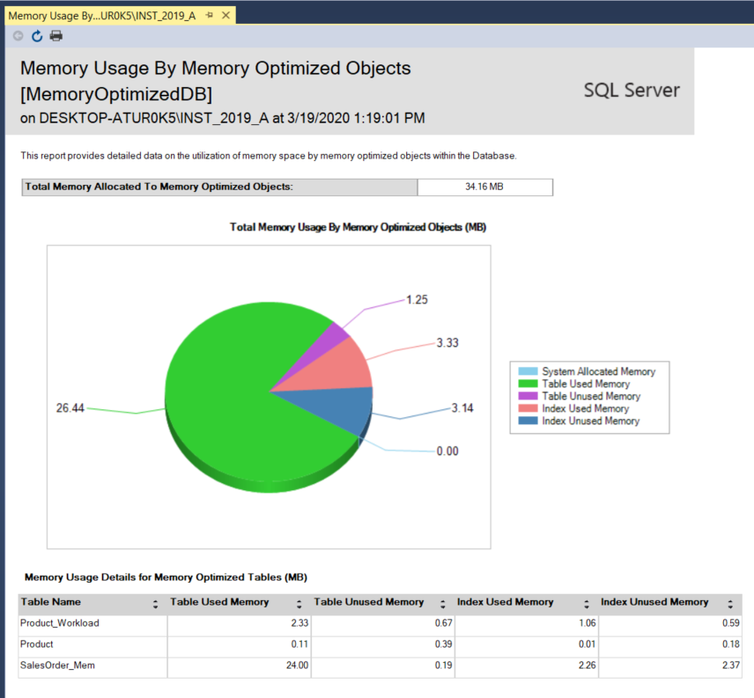
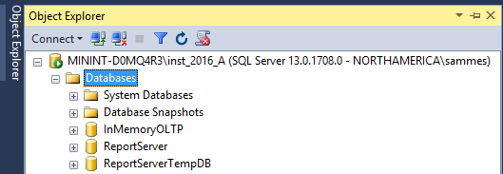
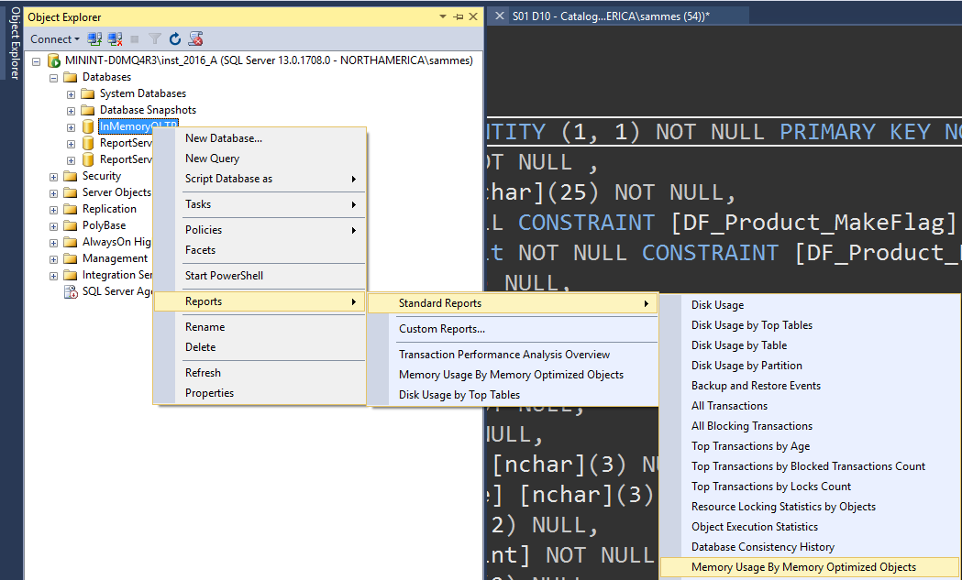
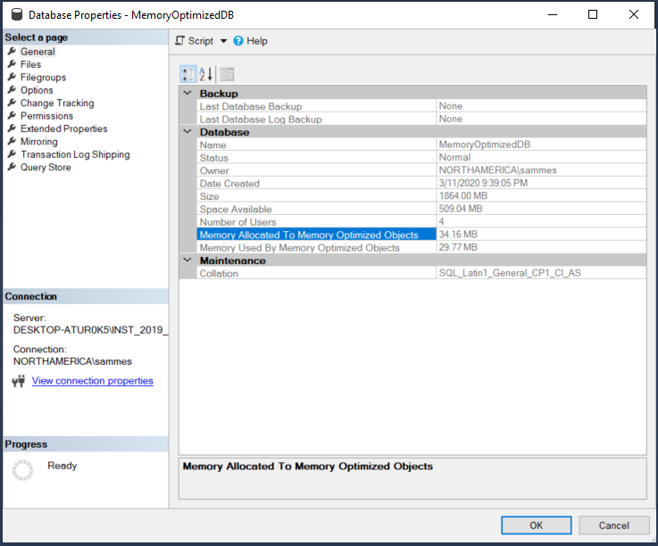
Memory-Optimized
Monitoring memory consumption
Built-in standard Database Reports are available to monitor memory consumption by memory-optimized tables
Right click on the database: Reports → Standard Reports → Memory Usage by Memory Optimized Objects
Notes:
Introduction to Memory-Optimized Tables
https://docs.microsoft.com/en-us/sql/relational-databases/in-memory-oltp/introduction-to-memory-optimized-tables?view=sql-server-ver15

Slide 87
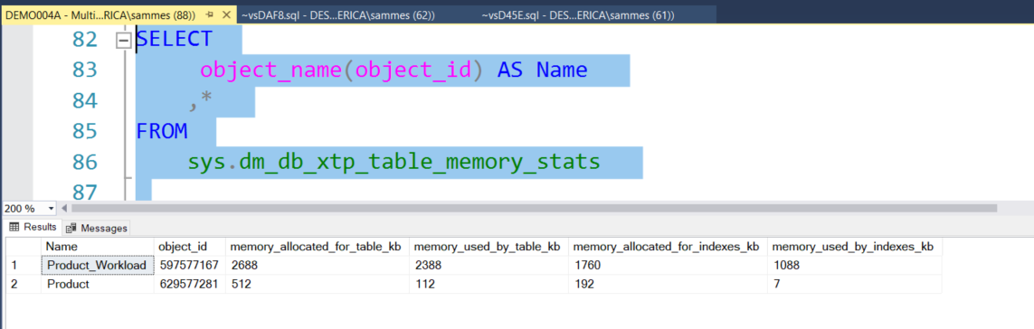
Memory-Optimized
Monitoring memory consumption
Notes:
Introduction to Memory-Optimized Tables
https://msdn.microsoft.com/en-us/library/dn511014.aspx

Slide 88
Demonstration
Memory utilization
Notes:
Previous demonstration files are under E:\Archived.
You can open all the demonstrations by using the solutions file :
E:\Demos\SQL_PTO_Optional_Demos.ssmssln
Individual SQL demo file.
E:\Demos\In Memory OLTP\
Run the script to create and populate a Memory-Optimized table. Show the time it takes to populate the table:
HashIndex_Monitoring_MemoryConsumption.sql

Slide 89
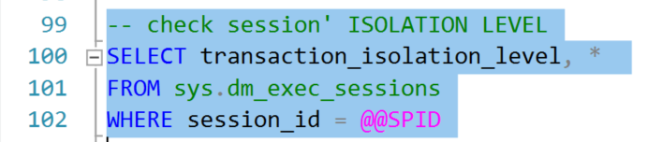
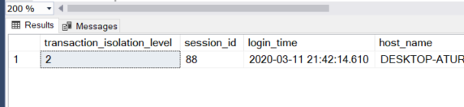
Memory-Optimized – lock free access
Isolation Level is the DEFAULT (Read Committed
Notes:
Introduction to Memory-Optimized Tables
https://docs.microsoft.com/en-us/sql/relational-databases/in-memory-oltp/introduction-to-memory-optimized-tables?view=sql-server-ver15

Slide 90
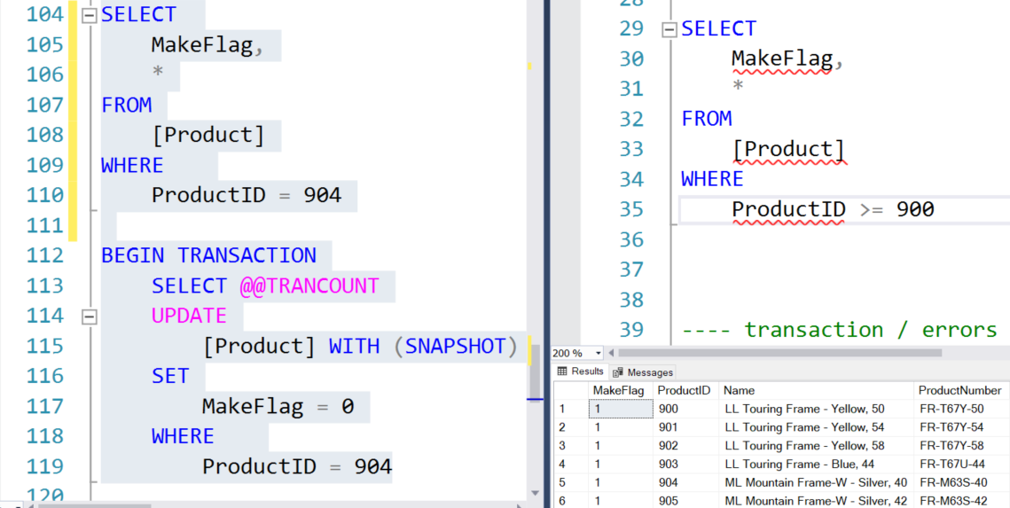
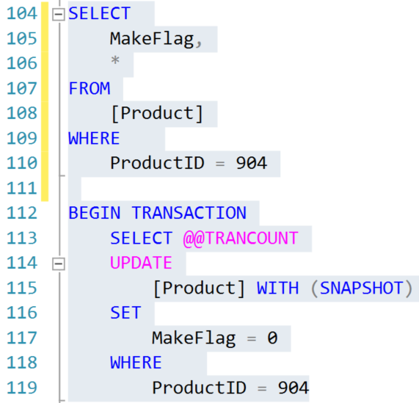
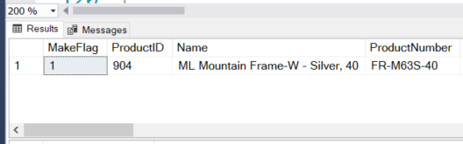
Memory-Optimized – lock free access
Isolation Level is the DEFAULT (Read Committed)
Session 1
Session 2
Can another session access this row that is being updated?
Notes:
Introduction to Memory-Optimized Tables
https://msdn.microsoft.com/en-us/library/dn511014.aspx
https://docs.microsoft.com/en-us/sql/relational-databases/in-memory-oltp/introduction-to-memory-optimized-tables?view=sql-server-ver15

Slide 91
Transaction Handling
Memory-Optimized
Allow optimistic concurrency control with higher isolation level:
REPEATABLE READ
SERIALIZABLE No locks are taken to enforce isolation level
A validation process is executed at the end of transactions
If two transactions try to update same row a write/write, a conflict happens and it results in error (41302)
Multi-Versioning
Snapshot-Based transaction isolation
Optimistic
Conflict Detection
Transaction Semantics for memory-optimized tables
When conflicts occur (that may cause inconsistencies in the database) these conflicts are detected, and transaction is terminated
Transactions assume there are no conflicts with concurrent transactions
Concurrent Transactions access potentially different versions of same row
A single Transaction use the same transactionally consistent snapshot of the table
Notes:
Transactions in Memory-Optimized Tables
https://docs.microsoft.com/en-us/sql/database-engine/transactions-in-memory-optimized-tables?view=sql-server-2014

Slide 92
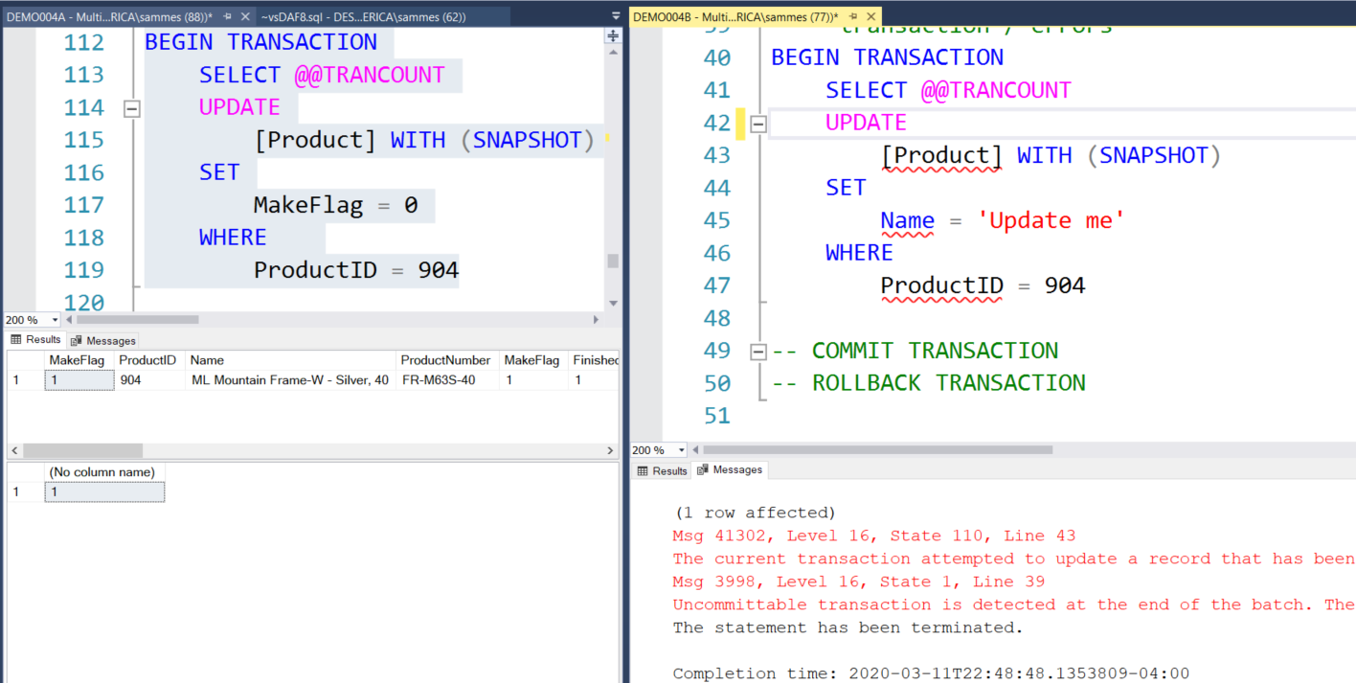
Transaction Handling
Without RETRY LOGIC
Transaction Conflict handling
Notes:
Introduction to Memory-Optimized Tables
https://docs.microsoft.com/en-us/sql/relational-databases/in-memory-oltp/introduction-to-memory-optimized-tables?view=sql-server-ver15

Slide 93
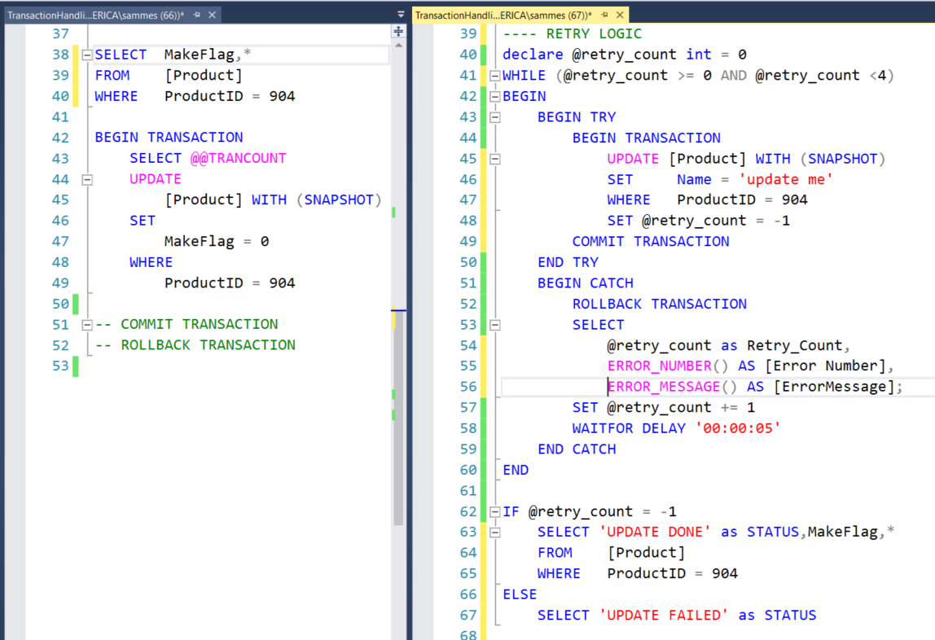
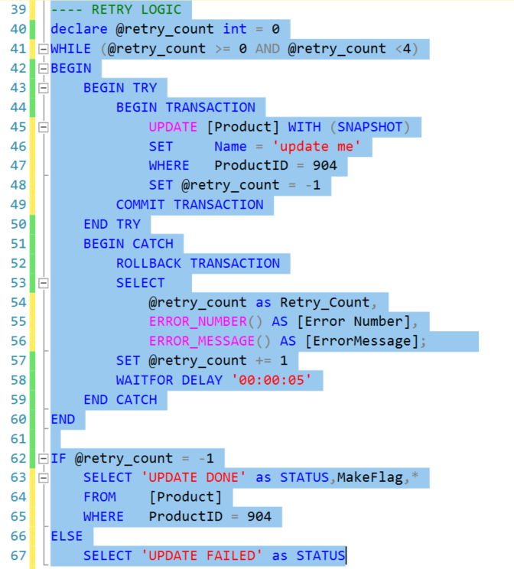
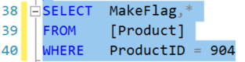
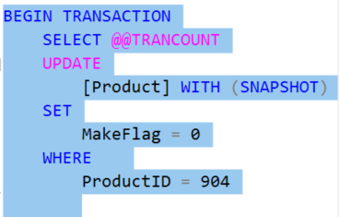
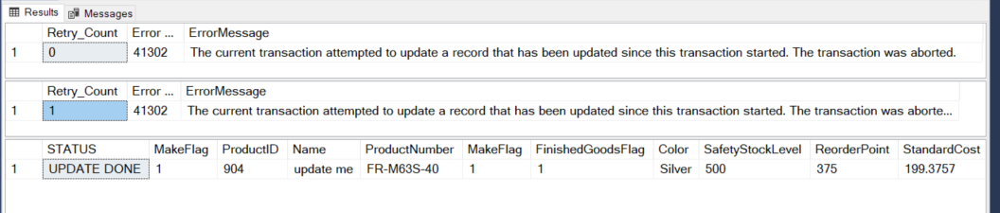
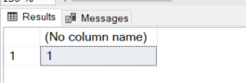


Transaction Handling
With RETRY LOGIC

Slide 94
Optional Demonstration
Concurrent Transactions & Retry Logic
Notes:
Previous demonstration files are under E:\Archived.
You can open all the demonstrations by using the solutions file :
E:\Demos\SQL_PTO_Optional_Demos.ssmssln
Individual SQL demo file.
E:\Demos\In Memory OLTP\
Run the script to create and populate a Memory-Optimized table.
TransactionHandling_1_TableSetup.sql
Run the script to run a select on 1 row, then open a transaction without committing or rolling back
TransactionHandling_2_FirstSession_BeginTran_UPDATE.sql
Open another script, create the second session on a vertical tab to show 2 sessions on SSMS
TransactionHandling_3_SecondSession_BeginTran_UPDATE_WITHOUT_RetryLogic
.. On this session execute the query before the transaction to show access to the row being updated on 1st session
.. Still on this script try to execute the BEGIN TRAN → error will happen
.. Close this script
Open another script, create the second session on a vertical tab to show 2 sessions on SSMS
TransactionHandling_4_SecondSession_BeginTran_UPDATE_WITH_RetryLogic
.. On this session execute the query before the transaction to show access to the row being updated on 1st session
.. Still on this script highlight and execute the TRANSACTION BLOCK
.. IF session 1 is still running for 4 X 00:00:05 sec (20 sec) this session will display a message showing ‘UPDATE FAILED’
.. IF session 1 has completed the transaction (with either COMMIT or ROLLBACK), then session 2 will complete and will list all errors while it was trying to execute the block
.. Close this script

Slide 95
Natively Compiled Stored Procedures
Native Compilation allows faster data access and more efficient query execution than Interpreted Transact-SQL (also called INTEROP)
The process converts T-SQL programming constructs into native code, which consists of processor instructions that won’t require further compilation or interpretation
Limitations with Native Compiled SPs:
Full Transact-SQL programmability is not implemented
Full Query Surface is not implemented
SCHEMABINDING is required
The procedure body must consist of exactly one ATOMIC BLOCK (with BEGIN ATOMIC)
Objects will get auto-recompilation at:
SQL Server restarts,
On database failover,
If database is taken offline and back online
Notes:
Creating Natively Compiled Stored Procedures
https://docs.microsoft.com/en-us/sql/relational-databases/in-memory-oltp/creating-natively-compiled-stored-procedures?view=sql-server-ver15
https://docs.microsoft.com/en-us/sql/relational-databases/in-memory-oltp/supported-features-for-natively-compiled-t-sql-modules?view=sql-server-ver15

Slide 96
Natively Compiled Stored Procedures
Comparison with Interpreted Stored Procedures
 | Natively Compiled | Interpreted
Initial Compilation | At Create Time | At First Execution
Automatic Recompilation | Upon 1st execution after database or server restart | On Server restart, or if evicted from plan cache
Manual Recompilation | Use sp_recompile | Use sp_recompile
Parameter Sniffing | Doesn’t apply. All parameters are considered to have UNKNOWN values | Use parameters from 1st execution to determine plan
Notes:
Creating Natively Compiled Stored Procedures
https://docs.microsoft.com/en-us/sql/relational-databases/in-memory-oltp/creating-natively-compiled-stored-procedures?view=sql-server-ver15
https://docs.microsoft.com/en-us/sql/relational-databases/in-memory-oltp/supported-features-for-natively-compiled-t-sql-modules?view=sql-server-ver15

Slide 97

Natively Compiled Stored Procedures
Compilation process
CREATE PROCEDURE is issued
Parser and Algebrizer create the processing flow.
Optimizer creates optimized query execution plans.
In-Memory OLTP compiler generates a DLL containing machine code
DLL is loaded into memory.
Notes:
Creating Natively Compiled Stored Procedures
https://docs.microsoft.com/en-us/sql/relational-databases/in-memory-oltp/creating-natively-compiled-stored-procedures?view=sql-server-ver15
The user issues a CREATE PROCEDURE statement to SQL Server.
The parser and algebrizer create the processing flow for the procedure, as well as query trees for the Transact-SQL queries in the stored procedure.
The optimizer creates optimized query execution plans for all the queries in the stored procedure.
The In-Memory OLTP compiler takes the processing flow with the embedded optimized query plans and generates a DLL that contains the machine code for executing the stored procedure.
The generated DLL is loaded into memory.

Slide 98



Memory-Optimized objects
Analysis tool
Wizard:
Analysis of existing tables and stored procedures to identify bottlenecks in the database.
Assistance to migrate these disk-based objects into Memory-Optimized.
Notes:
Note that in SQL Server 2014 you needed to set up a Management Data Warehouse (MDW) in order to run the In-Memory OLTP reports. SQL Server 2016 now includes lightweight reports available in SSMS without setting up MDW.
Open SSMS and right click on your database and select Reports | Standard Reports | Transaction Performance Analysis Overview.
Select the Tables Analysis report link.
This presents you with a prioritized plot chart that graphs the amounts of potential gain against the potential amount of work to migrate the top tables to In-Memory OLTP. This analysis is based upon the workload that we just ran with the batch file. This helps you see the highest potential gain with the lowest potential amount of migration work required.
Select the SalesOrderDetail_ondisk to explore further.
Note that this report contains information on latch statistics, lock statistics, recommended In-Memory index type, and more.
Click the Navigate Backwards button twice in the upper left of the report bar (see illustration above) to go back to the main Report and click on Stored Procedure Analysis.

Slide 99
Optional Demonstration
Natively compiled Stored Procedure
Notes:
Previous demonstration files are under E:\Archived.
You can open all the demonstrations by using the solutions file :
E:\Demos\SQL_PTO_Optional_Demos.ssmssln
Individual SQL demo file.
E:\Demos\In Memory OLTP\
Run the script to create and populate a Memory-Optimized table. This script uses 3 SPs to compare their performance.
Execute one block at a time, to show time in milliseconds
NativelyCompiled_SP.sql

Slide 100
Exploring In-memory OLTP Performance
Comparing performance between Disk-Based and Memory-Optimized Tables
Notes:
M05L06Lab01

Slide 101
Questions?

Slide 102
Knowledge Check
What is the primary storage for Memory-Optimized Tables?
What is the impact of having too many indexes on a Memory-Optimized Table?
What impact can possibly happen with a HASH index with a small bucket count?
What is the memory impact on having a HASH index with a large bucket count?
Are there performance advantages of having a non-chatty Natively Stored Procedure?
True or False: The index contents for Memory-Optimized Tables stored in the data file
Notes:
Q1: What is the primary storage for Memory-Optimized Tables?
A1: memory
Q2: TRUE OR FALSE: is the index contents for Memory-Optimized Tables stored in the data file?
A2: FALSE
Q3: what is the impact of having too many indexes on a Memory-Optimized Table?
A3: memory consumption can be high
Q4: what impact can possibly happen with a HASH index with a small bucket count?
A4: HASH Collisions, taking longer to access the needed row
Q5: what is the memory impact on having a HASH index with a large bucket count?
A5: with large bucket count we avoid HASH collisions at the expense of more memory allocation
Q6: Are there performance advantages of having a non-chatty Natively Stored Procedure?
A6: Non-Chatty SPs will perform much faster

Slide 103
Extra: SQL Server Intelligent Query Processing

Slide 104
Objectives
After completing this learning, you will be able to:
Understand the Intelligent query processing features.
Enable/disable Intelligent query processing features.

Slide 105
A History of Intelligent Query Processing
Intelligent Query Processing (2019)
Adaptive Query Processing (2017)
New Features of IQP (2022)

Slide 106
Adaptive Query Processing (2017)
Interleaved Execution
Memory Grant Feedback
Adaptive Joins
Adaptive Query Processing
Batch Mode
Notes:
https://docs.microsoft.com/en-us/sql/relational-databases/performance/intelligent-query-processing?view=sql-server-ver16
Parameter-sensitive? GLOBAL query
GLOBAL: Do not capitalize generic terms. Please note that we do not capitalize terms unless they are from the UI or are feature or product names. Please consider lowercasing such terms throughout this document.
GLOBAL: Please avoid using first person (“we”, “I”) Always use “you” or “Microsoft” if that is applicable.
…have a lot of …?

Slide 107
Intelligent Query Processing (2019)
Interleaved Execution
Memory Grant Feedback
Adaptive Joins
Intelligent Query Processing
Adaptive Query Processing
Batch Mode
Row Mode
Table Variable Deferred Compilation
Batch Mode On Rowstore Indexes
Scalar UDF Inlining
Approximate Query Processing
Approximate Count Distinct
Azure SQL Database
SQL Server 2017
SQL Server 2019
Notes:
Parameter-sensitive? GLOBAL query
GLOBAL: Do not capitalize generic terms. Please note that we do not capitalize terms unless they are from the UI or are feature or product names. Please consider lowercasing such terms throughout this document.
GLOBAL: Please avoid using first person (“we”, “I”) Always use “you” or “Microsoft” if that is applicable.
…have a lot of …?

Slide 108
Intelligent Query Processing (2022)
Interleaved Execution
Adaptive Joins
Intelligent Query Processing
Adaptive Query Processing
Batch Mode
Feedback Persistence
Table Variable Deferred Compilation
Batch Mode On Rowstore Indexes
Scalar UDF Inlining
Approximate Query Processing
Approximate Count Distinct
Memory Grant Feedback
Row Mode
Approximate Percentile
Parameter Sensitive Plan Optimization
CE Feedback
DOP Feedback
Optimized Plan Forcing
Azure SQL Database
http://aka.ms/IQP
2017
2019
2022
Notes:
Parameter-sensitive? GLOBAL query
GLOBAL: Do not capitalize generic terms. Please note that we do not capitalize terms unless they are from the UI or are feature or product names. Please consider lowercasing such terms throughout this document.
GLOBAL: Please avoid using first person (“we”, “I”) Always use “you” or “Microsoft” if that is applicable.
…have a lot of …?

Slide 109
Enabling and Disabling – Instance Level
For SQL Server 2017 Features
Enabled by default in Compatibility level 140 or higher
To disable change compatibility level to 130 or lower
For SQL Server 2019 Features
Enabled by default in Compatibility level 150 or higher
To disable change compatibility level to 140 or lower
For SQL Server 2022 Features
Enabled by default in Compatibility level 160 or higher
To disable change compatibility level to 150 or lower
Notes:
Parameter-sensitive? GLOBAL query
GLOBAL: Do not capitalize generic terms. Please note that we do not capitalize terms unless they are from the UI or are feature or product names. Please consider lowercasing such terms throughout this document.
GLOBAL: Please avoid using first person (“we”, “I”) Always use “you” or “Microsoft” if that is applicable.
…have a lot of …?

Slide 110

Enabling and Disabling – Database Level
Different settings for 2017 vs Azure SQL, SQL Server 2019 and higher
ALTER DATABASE SCOPED CONFIGURATION SET DISABLE_BATCH_MODE_ADAPTIVE_JOINS = ON|OFF;
ALTER DATABASE SCOPED CONFIGURATION SET BATCH_MODE_ADAPTIVE_JOINS = ON|OFF;
To get a list of Database Scoped Configuration settings
SELECT * From sys.database_scoped_configurations;
Notes:
Parameter-sensitive? GLOBAL query
GLOBAL: Do not capitalize generic terms. Please note that we do not capitalize terms unless they are from the UI or are feature or product names. Please consider lowercasing such terms throughout this document.
GLOBAL: Please avoid using first person (“we”, “I”) Always use “you” or “Microsoft” if that is applicable.
…have a lot of …?

Slide 111

Enabling and Disabling – Statement Level
You can disable features at the statement scope if necessary.
<statement>
OPTION (USE HINT('DISABLE_BATCH_MODE_ADAPTIVE_JOINS'));
To get a list of valid query use hints
SELECT * FROM sys.dm_exec_valid_use_hints;
Notes:
Parameter-sensitive? GLOBAL query
GLOBAL: Do not capitalize generic terms. Please note that we do not capitalize terms unless they are from the UI or are feature or product names. Please consider lowercasing such terms throughout this document.
GLOBAL: Please avoid using first person (“we”, “I”) Always use “you” or “Microsoft” if that is applicable.
…have a lot of …?

Slide 112
Adaptive Query Processing (2017)
Interleaved Execution
Memory Grant Feedback
Adaptive Joins
Adaptive Query Processing
Batch Mode
Addresses performance issues related to the cardinality estimation of an execution plan.
These options can provide improved join type selection, row-calculations for Multi-Statement Table-Valued Functions, and memory allocation of row storage.
Notes:
Parameter-sensitive? GLOBAL query
GLOBAL: Do not capitalize generic terms. Please note that we do not capitalize terms unless they are from the UI or are feature or product names. Please consider lowercasing such terms throughout this document.
GLOBAL: Please avoid using first person (“we”, “I”) Always use “you” or “Microsoft” if that is applicable.
…have a lot of …?

Slide 113
Batch Mode Adaptive Joins (2017)
Interleaved Execution
Memory Grant Feedback
Adaptive Joins
Adaptive Query Processing
Batch Mode
This feature enables the choice of either the Hash or the Nested Loop join type.
Decision is deferred until statement execution.
No need to use join hints in queries.
Notes:
Parameter-sensitive? GLOBAL query
GLOBAL: Do not capitalize generic terms. Please note that we do not capitalize terms unless they are from the UI or are feature or product names. Please consider lowercasing such terms throughout this document.
GLOBAL: Please avoid using first person (“we”, “I”) Always use “you” or “Microsoft” if that is applicable.
…have a lot of …?

Slide 114


Batch Mode Adaptive Joins (2017)
Adaptive Joins
Notes:
Parameter-sensitive? GLOBAL query
GLOBAL: Do not capitalize generic terms. Please note that we do not capitalize terms unless they are from the UI or are feature or product names. Please consider lowercasing such terms throughout this document.
GLOBAL: Please avoid using first person (“we”, “I”) Always use “you” or “Microsoft” if that is applicable.
…have a lot of …?

Slide 115
Interleaved Execution (2017)
Interleaved Execution
Memory Grant Feedback
Adaptive Joins
Adaptive Query Processing
Batch Mode
Previously, when a Multi-Statement Table-Valued Function was executed, it used a fixed row estimate of 100 rows.
Now execution is paused so a better cardinality estimate can be captured.
Notes:
Parameter-sensitive? GLOBAL query
GLOBAL: Do not capitalize generic terms. Please note that we do not capitalize terms unless they are from the UI or are feature or product names. Please consider lowercasing such terms throughout this document.
GLOBAL: Please avoid using first person (“we”, “I”) Always use “you” or “Microsoft” if that is applicable.
…have a lot of …?

Slide 116



Interleaved Execution (2017)
Interleaved Execution
Compatibility Level 120/130
Compatibility Level 140 or higher
During optimization if SQL Server encounter a read-only multi-statement table-valued function (MSTVF), it will pause optimization, execute the applicable subtree, capture accurate cardinality estimates, and then resume optimization for downstream operations.
Notes:
Parameter-sensitive? GLOBAL query
GLOBAL: Do not capitalize generic terms. Please note that we do not capitalize terms unless they are from the UI or are feature or product names. Please consider lowercasing such terms throughout this document.
GLOBAL: Please avoid using first person (“we”, “I”) Always use “you” or “Microsoft” if that is applicable.
…have a lot of …?

Slide 117
Batch Mode Memory Grant Feedback (2017)
Interleaved Execution
Memory Grant Feedback
Adaptive Joins
Adaptive Query Processing
Batch Mode
When compiling an execution plan, the query engine estimates how much memory is needed to store rows during join and sort operations.
Too much memory allocation may impact performance of other operations. Not enough will cause a spill over to disk.
This feature recalculates memory on first execution and updates the cached plan.
Notes:
Parameter-sensitive? GLOBAL query
GLOBAL: Do not capitalize generic terms. Please note that we do not capitalize terms unless they are from the UI or are feature or product names. Please consider lowercasing such terms throughout this document.
GLOBAL: Please avoid using first person (“we”, “I”) Always use “you” or “Microsoft” if that is applicable.
…have a lot of …?

Slide 118




Batch Mode Memory Grant Feedback (2017)
First Execution (Spills detected; feedback generated)
Memory Grant Feedback (Batch Mode)
Second Execution (Memory grant adjusted)
Notes:
Parameter-sensitive? GLOBAL query
GLOBAL: Do not capitalize generic terms. Please note that we do not capitalize terms unless they are from the UI or are feature or product names. Please consider lowercasing such terms throughout this document.
GLOBAL: Please avoid using first person (“we”, “I”) Always use “you” or “Microsoft” if that is applicable.
…have a lot of …?

Slide 119
Row Mode Memory Grant Feedback (2019)
Interleaved Execution
Memory Grant Feedback
Adaptive Joins
Adaptive Query Processing
Batch Mode
Row Mode
Row Mode is just like Batch Mode, but different.
Notes:
Parameter-sensitive? GLOBAL query
GLOBAL: Do not capitalize generic terms. Please note that we do not capitalize terms unless they are from the UI or are feature or product names. Please consider lowercasing such terms throughout this document.
GLOBAL: Please avoid using first person (“we”, “I”) Always use “you” or “Microsoft” if that is applicable.
…have a lot of …?

Slide 120

Row Mode Memory Grant Feedback (2019)
Expands on the batch mode memory grant feedback feature by also adjusting memory grant sizes for row mode operators.
Memory Grant Feedback (Row Mode)
Two new query plan attributes will be shown for actual post-execution plans.
Notes:
Parameter-sensitive? GLOBAL query
GLOBAL: Do not capitalize generic terms. Please note that we do not capitalize terms unless they are from the UI or are feature or product names. Please consider lowercasing such terms throughout this document.
GLOBAL: Please avoid using first person (“we”, “I”) Always use “you” or “Microsoft” if that is applicable.
…have a lot of …?

Slide 121
Feedback Persistence (2022)
Interleaved Execution
Memory Grant Feedback
Adaptive Joins
Adaptive Query Processing
Batch Mode
Row Mode
Feedback Persistence
DOP Feedback
CE Feedback
Notes:
Parameter-sensitive? GLOBAL query
GLOBAL: Do not capitalize generic terms. Please note that we do not capitalize terms unless they are from the UI or are feature or product names. Please consider lowercasing such terms throughout this document.
GLOBAL: Please avoid using first person (“we”, “I”) Always use “you” or “Microsoft” if that is applicable.
…have a lot of …?

Slide 122
Feedback Persistence and Percentile (2022)
Problem: Cache Eviction
Feedback is not persisted if the plan is evicted from cache or failover
Solution: Persist the feedback
Persist the memory grant feedback in the Query Store
Record of how to adjust memory is lost and must re-learn
Problem: Oscillating Feedback
Memory grants adjusted based on last feedback
Parameter Sensitive Plans could change feedback
Solution: Percentile-based calculation
Smooths the grant size values based on execution usage history
Notes:
Parameter-sensitive? GLOBAL query
GLOBAL: Do not capitalize generic terms. Please note that we do not capitalize terms unless they are from the UI or are feature or product names. Please consider lowercasing such terms throughout this document.
GLOBAL: Please avoid using first person (“we”, “I”) Always use “you” or “Microsoft” if that is applicable.
…have a lot of …?

Slide 123


Feedback Persistence and Percentile (2022)
Notes:
Parameter-sensitive? GLOBAL query
GLOBAL: Do not capitalize generic terms. Please note that we do not capitalize terms unless they are from the UI or are feature or product names. Please consider lowercasing such terms throughout this document.
GLOBAL: Please avoid using first person (“we”, “I”) Always use “you” or “Microsoft” if that is applicable.
…have a lot of …?

Slide 124
Cardinality Estimator Feedback (2022)
Interleaved Execution
Memory Grant Feedback
Adaptive Joins
Adaptive Query Processing
Batch Mode
Row Mode
Feedback Persistence
DOP Feedback
CE Feedback
Notes:
Parameter-sensitive? GLOBAL query
GLOBAL: Do not capitalize generic terms. Please note that we do not capitalize terms unless they are from the UI or are feature or product names. Please consider lowercasing such terms throughout this document.
GLOBAL: Please avoid using first person (“we”, “I”) Always use “you” or “Microsoft” if that is applicable.
…have a lot of …?

Slide 125
Cardinality Estimator Feedback (2022)
Problem: Incorrect Assumptions for Cardinality Estimates
The cardinality estimator sometimes makes incorrect assumptions
Solution: Learn from historical CE model assumptions
CE Feedback will evaluate accuracy for repeated queries
Cardinality Estimation Today
CE determines the estimated number of rows for a query plan
CE models are based on statistics and assumptions about the distribution of data
One CE models doesn’t fit all scenarios
If assumption looks incorrect, test a different CE model assumption and verify if it helps
If a CE model assumption does help, it will replace the current plan in cache.
Learn more about CE models and assumptions https://aka.ms/sqlCE
Poor assumptions leads to poor query plans.
Notes:
Parameter-sensitive? GLOBAL query
GLOBAL: Do not capitalize generic terms. Please note that we do not capitalize terms unless they are from the UI or are feature or product names. Please consider lowercasing such terms throughout this document.
GLOBAL: Please avoid using first person (“we”, “I”) Always use “you” or “Microsoft” if that is applicable.
…have a lot of …?

Slide 126
Degree of Parallelism Feedback (2022)
Interleaved Execution
Memory Grant Feedback
Adaptive Joins
Adaptive Query Processing
Batch Mode
Row Mode
Feedback Persistence
DOP Feedback
CE Feedback
Notes:
Parameter-sensitive? GLOBAL query
GLOBAL: Do not capitalize generic terms. Please note that we do not capitalize terms unless they are from the UI or are feature or product names. Please consider lowercasing such terms throughout this document.
GLOBAL: Please avoid using first person (“we”, “I”) Always use “you” or “Microsoft” if that is applicable.
…have a lot of …?

Slide 127
Degree of Parallelism Feedback (2022)
DOP Feedback
Parallelism Today
Parallelism is often beneficial for querying large amounts of data, but transactional queries could suffer when time spent coordinating threads outweighs the advantages of using a parallel plan
Before SQL Server 2019, default value for MAXDOP = 0
With SQL Server 2019, default is calculated at setup based on available processors
Azure SQL Database the default MAXDOP is 8
Current Settings
DOP Feedback will identify parallelism inefficiencies for repeating queries, based on CPU time, elapsed time, and waits
If parallelism usage is inefficient, the DOP will be lowered for next execution (min DOP = 2) and then verify if it helps
Only verified feedback is persisted (Query Store). - If next execution regresses, back to last good known DOP
Notes:
Parameter-sensitive? GLOBAL query
GLOBAL: Do not capitalize generic terms. Please note that we do not capitalize terms unless they are from the UI or are feature or product names. Please consider lowercasing such terms throughout this document.
GLOBAL: Please avoid using first person (“we”, “I”) Always use “you” or “Microsoft” if that is applicable.
…have a lot of …?

Slide 128
Intelligent Query Processing (2022)
Interleaved Execution
Adaptive Joins
Intelligent Query Processing
Adaptive Query Processing
Batch Mode
Feedback Persistence
Table Variable Deferred Compilation
Batch Mode On Rowstore Indexes
Scalar UDF Inlining
Approximate Query Processing
Approximate Count Distinct
Memory Grant Feedback
Row Mode
Approximate Percentile
Parameter Sensitive Plan Optimization
CE Feedback
DOP Feedback
Optimized Plan Forcing
Azure SQL Database
http://aka.ms/IQP
2017
2019
2022
Notes:
Parameter-sensitive? GLOBAL query
GLOBAL: Do not capitalize generic terms. Please note that we do not capitalize terms unless they are from the UI or are feature or product names. Please consider lowercasing such terms throughout this document.
GLOBAL: Please avoid using first person (“we”, “I”) Always use “you” or “Microsoft” if that is applicable.
…have a lot of …?

Slide 129
Intelligent Query Processing (2019 Features)
Intelligent Query Processing
Table Variable Deferred Compilation
Batch Mode On Rowstore Indexes
Scalar UDF Inlining
Approximate Query Processing
Approximate Count Distinct
Notes:
Parameter-sensitive? GLOBAL query
GLOBAL: Do not capitalize generic terms. Please note that we do not capitalize terms unless they are from the UI or are feature or product names. Please consider lowercasing such terms throughout this document.
GLOBAL: Please avoid using first person (“we”, “I”) Always use “you” or “Microsoft” if that is applicable.
…have a lot of …?

Slide 130
Table Variable Deferred Compilation
Intelligent Query Processing
Table Variable Deferred Compilation
Batch Mode On Rowstore Indexes
Scalar UDF Inlining
Approximate Query Processing
Approximate Count Distinct
Queries that contain table variables will defer the compilation of the execution plan until the first execution of the query statement. This allows the execution plan to use the actual cardinality of the table variable instead of a one row guess.
Notes:
Parameter-sensitive? GLOBAL query
GLOBAL: Do not capitalize generic terms. Please note that we do not capitalize terms unless they are from the UI or are feature or product names. Please consider lowercasing such terms throughout this document.
GLOBAL: Please avoid using first person (“we”, “I”) Always use “you” or “Microsoft” if that is applicable.
…have a lot of …?

Slide 131
Batch Mode on Rowstore Indexes
Intelligent Query Processing
Table Variable Deferred Compilation
Batch Mode On Rowstore Indexes
Scalar UDF Inlining
Approximate Query Processing
Approximate Count Distinct
Allows batch mode execution for analytic workloads without requiring columnstore indexes.
Notes:
Parameter-sensitive? GLOBAL query
GLOBAL: Do not capitalize generic terms. Please note that we do not capitalize terms unless they are from the UI or are feature or product names. Please consider lowercasing such terms throughout this document.
GLOBAL: Please avoid using first person (“we”, “I”) Always use “you” or “Microsoft” if that is applicable.
…have a lot of …?

Slide 132
Scalar User-Defined Function Inlining
Intelligent Query Processing
Table Variable Deferred Compilation
Batch Mode On Rowstore Indexes
Scalar UDF Inlining
Approximate Query Processing
Approximate Count Distinct
Scalar UDFs are automatically transformed into scalar expressions or scalar subqueries that are substituted in the calling query in place of the UDF operator.
Notes:
Parameter-sensitive? GLOBAL query
GLOBAL: Do not capitalize generic terms. Please note that we do not capitalize terms unless they are from the UI or are feature or product names. Please consider lowercasing such terms throughout this document.
GLOBAL: Please avoid using first person (“we”, “I”) Always use “you” or “Microsoft” if that is applicable.
…have a lot of …?

Slide 133
Approximate Query Processing
Intelligent Query Processing
Table Variable Deferred Compilation
Batch Mode On Rowstore Indexes
Scalar UDF Inlining
Approximate Query Processing
Approximate Count Distinct
Approximate Query Processing is a new feature family that will be used to aggregate large datasets where performance is more critical than absolute precision.
Notes:
Parameter-sensitive? GLOBAL query
GLOBAL: Do not capitalize generic terms. Please note that we do not capitalize terms unless they are from the UI or are feature or product names. Please consider lowercasing such terms throughout this document.
GLOBAL: Please avoid using first person (“we”, “I”) Always use “you” or “Microsoft” if that is applicable.
…have a lot of …?

Slide 134
Approximate Count Distinct (2019)
Intelligent Query Processing
Table Variable Deferred Compilation
Batch Mode On Rowstore Indexes
Scalar UDF Inlining
Approximate Query Processing
Approximate Count Distinct
A new aggregate function APPROX_COUNT_DISTINCT that returns the approximate number of unique non-null values in a group.
Notes:
Parameter-sensitive? GLOBAL query
GLOBAL: Do not capitalize generic terms. Please note that we do not capitalize terms unless they are from the UI or are feature or product names. Please consider lowercasing such terms throughout this document.
GLOBAL: Please avoid using first person (“we”, “I”) Always use “you” or “Microsoft” if that is applicable.
…have a lot of …?

Slide 135
Approximate Count Distinct
It returns the approximate number of unique non-null values in a group.
It is designed to provide aggregations across large data sets where responsiveness is more critical than absolute precision.
Guarantees up to a 2% error rate within a 97% probability.
Requires less memory than an exhaustive COUNT DISTINCT operation so it is less likely to spill memory to disk compared to COUNT DISTINCT.
Approximate Count Distinct
SELECT APPROX_COUNT_DISTINCT(O_OrderKey) AS Approx_Distinct_OrderKey
FROM dbo.Orders;
Notes:
Parameter-sensitive? GLOBAL query
GLOBAL: Do not capitalize generic terms. Please note that we do not capitalize terms unless they are from the UI or are feature or product names. Please consider lowercasing such terms throughout this document.
GLOBAL: Please avoid using first person (“we”, “I”) Always use “you” or “Microsoft” if that is applicable.
…have a lot of …?

Slide 136
Approximate Percentile (2022)
Intelligent Query Processing
Table Variable Deferred Compilation
Batch Mode On Rowstore Indexes
Scalar UDF Inlining
Approximate Query Processing
Approximate Count Distinct
Approximate Percentile
An aggregate function APPROX_PERCENTILE
that returns the approximate percentage of unique non-null values in a group.
Notes:
Parameter-sensitive? GLOBAL query
GLOBAL: Do not capitalize generic terms. Please note that we do not capitalize terms unless they are from the UI or are feature or product names. Please consider lowercasing such terms throughout this document.
GLOBAL: Please avoid using first person (“we”, “I”) Always use “you” or “Microsoft” if that is applicable.
…have a lot of …?

Slide 137
Optimized Plan Forcing (2022)
Intelligent Query Processing
Table Variable Deferred Compilation
Batch Mode On Rowstore Indexes
Scalar UDF Inlining
Approximate Query Processing
Approximate Count Distinct
Approximate Percentile
Parameter Sensitive Plan Optimization
Optimized Plan Forcing
Notes:
Parameter-sensitive? GLOBAL query
GLOBAL: Do not capitalize generic terms. Please note that we do not capitalize terms unless they are from the UI or are feature or product names. Please consider lowercasing such terms throughout this document.
GLOBAL: Please avoid using first person (“we”, “I”) Always use “you” or “Microsoft” if that is applicable.
…have a lot of …?

Slide 138
Optimized Plan Forcing (2022)
Query Compilation Today
Query optimization and compilation is a multi-phased process of quickly generating a “good-enough” query execution plan
Query execution time includes compilation. Can be time and resource consuming
To reduce compilation overhead for repeating queries, SQL caches query plans for re-use
Plans can be evicted from cache due to restarts or memory pressure
Subsequent calls to the query require a full new compilation
Notes:
Parameter-sensitive? GLOBAL query
GLOBAL: Do not capitalize generic terms. Please note that we do not capitalize terms unless they are from the UI or are feature or product names. Please consider lowercasing such terms throughout this document.
GLOBAL: Please avoid using first person (“we”, “I”) Always use “you” or “Microsoft” if that is applicable.
…have a lot of …?

Slide 139
Optimized Plan Forcing (2022)
Query Compilation Replay
Version 1 targets previously forced plans through Query Store and Automatic Plan Correction
Uses those previously-recorded CRS to quickly reproduce and cache the original forced plan at a fraction of the original compilation cost
Compatible with Query Store hints and secondary replica support
Stores a compilation replay script (CRS) that persists key compilation steps in Query Store (not user visible)
Notes:
Parameter-sensitive? GLOBAL query
GLOBAL: Do not capitalize generic terms. Please note that we do not capitalize terms unless they are from the UI or are feature or product names. Please consider lowercasing such terms throughout this document.
GLOBAL: Please avoid using first person (“we”, “I”) Always use “you” or “Microsoft” if that is applicable.
…have a lot of …?

Slide 140
Parameter Sensitive Plan Optimization (2022)
Intelligent Query Processing
Table Variable Deferred Compilation
Batch Mode On Rowstore Indexes
Scalar UDF Inlining
Approximate Query Processing
Approximate Count Distinct
Approximate Percentile
Optimized Plan Forcing
Parameter Sensitive Plan Optimization
Notes:
Parameter-sensitive? GLOBAL query
GLOBAL: Do not capitalize generic terms. Please note that we do not capitalize terms unless they are from the UI or are feature or product names. Please consider lowercasing such terms throughout this document.
GLOBAL: Please avoid using first person (“we”, “I”) Always use “you” or “Microsoft” if that is applicable.
…have a lot of …?

Slide 141
Parameter Sensitive Plans (2022)
Parameter Sensitive Plans Today
Parameter-sniffing problem refers to a scenario where a single cached plan for a parameterized query is not optimal for all possible input parameter values
RECOMPILE
Current Workarounds
If plan is not representative of most executions, you have a perceived “bad plan”
OPTION (OPTIMIZE FOR…)
OPTION (OPTIMIZE FOR UNKNOWN)
Disable parameter sniffing entirely
KEEPFIXEDPLAN
Force a known plan
Nested procedures
Dynamic string execution
Notes:
Parameter-sensitive? GLOBAL query
GLOBAL: Do not capitalize generic terms. Please note that we do not capitalize terms unless they are from the UI or are feature or product names. Please consider lowercasing such terms throughout this document.
GLOBAL: Please avoid using first person (“we”, “I”) Always use “you” or “Microsoft” if that is applicable.
…have a lot of …?

Slide 142


PSP today (Example of Real Estate agent's portfolio)
New compile on Agent 4
This example was borrowed from Pedro Lopes @SQLPedro

Slide 143




PSP today (Example of Real Estate agent's portfolio)
Using cached plan for Agent 2
New compile on Agent 2

Slide 144
PSP Optimization (2022)
Too many plans generated could create cache bloat, so limit # of plans in cache
Automatically enables multiple, active cached plans for a single parameterized statement
Cached execution plans will accommodate different data sizes based on the customer-provided runtime parameter value(s)
Design considerations
Overhead of PSP optimization must not outweigh downstream benefit
Compatible with Query Store plan forcing
Notes:
Parameter-sensitive? GLOBAL query
GLOBAL: Do not capitalize generic terms. Please note that we do not capitalize terms unless they are from the UI or are feature or product names. Please consider lowercasing such terms throughout this document.
GLOBAL: Please avoid using first person (“we”, “I”) Always use “you” or “Microsoft” if that is applicable.
…have a lot of …?

Slide 145
PSP Predicate Selection (2022)
During initial compilation PSP optimization will evaluate the most “at risk” parameterized predicates (up to three out of all available)
First version is scoped to equality predicates referencing statistics-covered columns; WHERE AgentId = @AgentId
Uses the statistics histogram to identify non-uniform distributions
Notes:
Parameter-sensitive? GLOBAL query
GLOBAL: Do not capitalize generic terms. Please note that we do not capitalize terms unless they are from the UI or are feature or product names. Please consider lowercasing such terms throughout this document.
GLOBAL: Please avoid using first person (“we”, “I”) Always use “you” or “Microsoft” if that is applicable.
…have a lot of …?

Slide 146

Boundary Value Selection (Dispatcher Plan)
Notes:
For each predicate chosen, we will bucketize them into predicate cardinality ranges based on the runtime cardinality. These plan variants are NOT pre-generated.
Max of 200 plans in QS, 27 plans in cache (up to 3 predicates pwr 3)

Slide 147
Intelligent Query Processing (2022)
Interleaved Execution
Adaptive Joins
Intelligent Query Processing
Adaptive Query Processing
Batch Mode
Feedback Persistence
Table Variable Deferred Compilation
Batch Mode On Rowstore Indexes
Scalar UDF Inlining
Approximate Query Processing
Approximate Count Distinct
Memory Grant Feedback
Row Mode
Approximate Percentile
Parameter Sensitive Plan Optimization
CE Feedback
DOP Feedback
Optimized Plan Forcing
Azure SQL Database
http://aka.ms/IQP
2017
2019
2022
Notes:
Parameter-sensitive? GLOBAL query
GLOBAL: Do not capitalize generic terms. Please note that we do not capitalize terms unless they are from the UI or are feature or product names. Please consider lowercasing such terms throughout this document.
GLOBAL: Please avoid using first person (“we”, “I”) Always use “you” or “Microsoft” if that is applicable.
…have a lot of …?

Slide 148
Demonstration
Intelligent query processing
Interleaved Execution
Batch Mode on RowStore
Memory Grant Feedback (Row Mode)
Notes:
Previous demonstration files are under E:\Archived.
You can open all the demonstrations by using the solutions file :
E:\Demos\SQL_PTO_Optional_Demos.ssmssln
Individual SQL demo file.
E:\Demos\Intelligent Query Processing\
aqp_interleaved.sql
iqp_batchmoderow.sql
iqp_rowmodemfg.sql

Slide 149
Intelligent query processing
Observing Batch-Mode Memory Grant Feedback
Using APPROX_COUNT_DISTINCT to improve performance
Observing Table Variable Deferred Compilation
Observing Scalar UDF Inlining
Notes:
M07L04Lab01

Slide 150
Questions?

Slide 151
Knowledge Check
Is it possible to disable Intelligent Query Processing features?
On queries not using Interleaved execution for MSTVFs. How many rows are estimated for a MSTVFs?
On queries not using table variable deferred compilation. How many rows are estimated for a table variable?
Does table variable deferred compilation increase the recompilation frequency?
What is the minimum compatibility level that supports Batch mode on rowstore?
Notes:
Q1: Is it possible to disable Intelligent Query Processing features?
A1: Yes, you can disable all IQP features by reducing the compatibility level of the database. In some cases you can use ALTER DATABASE SCOPED CONFIGURATION to disable the feature and you can also use query hits to disable the feature at sentence level.
Q2: On queries not using Interleaved execution for MSTVFs. How many rows are estimated for a MSTVFs?
A2: MSTVFs have a fixed cardinality guess of 100 starting with SQL Server 2014 (12.x), and 1 for earlier SQL Server versions.
Q3 Does table variable deferred compilation increase the recompilation frequency?
A3: Table variable deferred compilation doesn't increase recompilation frequency. Rather, it shifts where the initial compilation occurs. The resulting cached plan generates based on the initial deferred compilation table variable row count.
Q4: On queries not using table variable deferred compilation. How many rows are estimated for a table variable?
A4: A fixed guess of 1 row
Q5: What is the minimum compatibility level that supports Batch mode on rowstore?
A5: 150

Slide 152
Extra: SQL Server Resource Governor

Slide 153
Objectives
After completing this learning, you will be able to:
Understand how Resource Governor works.
Understand how to configure Resource Governor.

Slide 154
Resource Governor – Feature Overview
SQL Server
2008
SQL Server
2012
SQL Server
2014
Resource Governor was first introduced
CPU and Memory Governance
CPU_CAP_PERCENT
Affinity and NUMA
IO Governance
Feature Goals
Minimize runaway queries
Improve the predictable performance of queries across the SQL Server engine
Notes:
Resource Governor – Feature Overview
This is a history lesson of the release of SQL Server Resource Governor. It is important to be aware of the key release improvements per version.
SQL Server Resource Governor was first introduced in 2008. In this first release, we brought in CPU and Memory controls.
In SQL Server 2012, to answer customer hosting needs, we introduced the ability to cap the CPU and the ability to affinitize the CPU.
SQL Server 2014 added the ability to govern IO. The key effort was to address runaway queries across the resources.

Slide 155
Notes continued
Notes:
Note: The ability to govern physical IO only applies to user operations and not to system tasks. System tasks include write operations to the transaction log, resource monitor, checkpoint operations, Lazy Writer IO operations, and other internal operations. You cannot limit the internal pool which is where system tasks go by default.
Additionally, because the limits happen at the storage level, it is possible to align your RG strategy with storage tiers in Windows Server 2012 or Windows Server 2012 R2.
Resource Governor
https://docs.microsoft.com/en-us/sql/relational-databases/resource-governor/resource-governor?view=sql-server-ver15
Removed the exclamation points
RG is not listed in Term Studio as an approved acronym for resource Governor. Please check if you want to use it.

Slide 156
Introduction to Resource Governor
Notes:
What is Resource Governor?
Introduced in SQL Server 2008 to promote predictable performance by specifying limits on resource consumption (CPU and Memory only).
SQL Server 2012 introduced additional CPU limits, increased the number of resource pools, allowed better memory control, added affinity, and Non-Uniform Memory Access (NUMA) support.
SQL Server 2014 introduced the ability to govern I/O.
Classifies workloads based on multiple deterministic conditions: login name, application name, host name, server role, and so on.
Database engine only, Enterprise Edition only
Resource Governor does not impose any controls on a dedicated administrator connection (DAC). The DAC runs in the internal workload group and resource pool.
What is Resource Governor?
Resource Governor is a technology introduced in SQL Server 2008 that enables you to manage SQL Server workloads and resources by specifying limits on resource consumption on incoming requests. Resource limits can be reconfigured in real time with minimal impact on workloads that are executing. In an environment where multiple distinct workloads are present on the same server, Resource Governor enables you to differentiate these workloads and allocate shared resources as they are requested, based on the limits that you specify.
Resource Governor applies to the Database Engine which allows you to place controls on the resources of CPU, memory, and IO at the Resource Pool-level and also control the maximum number of requests, memory grant percentage, degree of parallelism, and more at the Workload Group level. Based on the Classifier function that fires on every incoming request, Resource Governor can apply its governance to a single user / group or to all requests with the application name of ‘%Reporting Services%’ or ‘%Excel%’, for example. The Classifier function allows the database administrator (DBA).
This is not capitalized as per Term Studio. Please refer to the following guideline
GLOBAL: Do not capitalize generic terms. Please note that we do not capitalize terms unless they are from the UI or are feature or product names. Please consider lowercasing such terms throughout this document.
Please do not hyperlink words or text to provide links to external resources or URLs. Provide the URL or link directly ad explicitly
Please avoid using first person “we”, “I”, or “our”. Always use “you” or “Microsoft” if that is applicable.
I have seen this term being abbreviated as XE also. This acronym has not yet been defined. Please define this as extent events at the first instance before using this acronym.

Slide 157
Notes:
to identify deterministic outputs and to direct these outputs to a Workload Group to control resource consumption. We will cover these Resource Governor concepts, architecture, and Resource Governor components in depth later in this discussion.
Note: Resource Governor is available only on the Enterprise, Developer, and Evaluation editions of SQL Server.
With SQL Server 2012, you can promote a more complete isolation of CPU resources for workloads, put caps on the CPU usage for higher levels of predictability, and control a greater amount of SQL Server memory allocations.
The following features were added in SQL Server 2012:
Increasing the maximum number of resource pools from 20 to 64 and enabling partitioning of larger machines between more workloads.
Adding a CAP_CPU_PERCENT option to resource pools to set a hard-cap limit on the CPU resource usage, providing greater predictability.
Adding an AFFINITY option to resource pools, allowing individual resource pools to be affinitized to one or more schedulers and NUMA nodes, providing greater isolation of CPU resources.
Governance of multiple page allocations by the SQL Server Memory Manager in addition to single page allocations. This is a result of a major redesign in SQL Server 2012, with the Memory Manager becoming the central operating system interface for page allocation.
Please ensure that you use a consistent font style and size.

Slide 158
Notes:
Note: For more information about Memory Manager changes, see the SQLOS & Cloud Infrastructure Team blog (http://blogs.msdn.com/b/sqlosteam/).
The following features were added in SQL Server 2014:
SQL Server 2014 added the new IO Resource Governor feature in addition to the existing CPU and Memory governor pools.
Resource Pools now supports the configuration of minimum and maximum IOPS per volume in addition to CPU/Memory settings enabling more comprehensive resource isolation controls.
Ability to configure the maximum outstanding IO per volume (at instance scope). This knob is meant to calibrate the resource governor feature for your storage subsystem.
Note: As a note of clarification, by volume, we refer to the disk volume as identified by Windows File system APIs
We have added new columns in the sys.dm_resource_governor_resource_pools and sys.dm_resource_governor_configuration dynamic management views to surface the IO usage and configuration. In addition, we have also added a new DMV called sys.dm_resource_governor_resource_pool_volumes that captures IO usage stats across different volumes used by the instance.
Two new XEvents (file_write_enqueued, file_read_enqueued) were added to monitor IO requests to the IO Resource Manager queues. These XEvents follow the conventions of the existing IO related events, such as issuing IO and IO completion.
Added relevant performance counters such as Disk Read IO/sec, Disk Read Bytes/sec, Avg Disk Read IO (ms), Disk Write IO/sec, Disk Write Bytes/sec, Avg Disk Write IO (ms), Disk Read IO Throttled/sec, and Disk Write IO Throttled/sec to the SQLServer:Resource Pool Stats.
Reference:
Do not use underlining as a means of emphasizing something.

Slide 159
Notes:
Resource Governor Considerations and Limitations
This release of Resource Governor has the following constraints:
Resource management is limited to the SQL Server Database Engine. Resource Governor cannot be used for SQL Server Analysis Services (SSAS), SQL Server Integration Services (SSIS), and SQL Server Reporting Services (SSRS).
There is no workload monitoring or workload management between SQL Server instances.
Limit specification applies to CPU bandwidth and memory managed by SQL Server.
If a resource is exceeded by a single query, it does not automatically terminate the query. For example, the workload request maximum CPU time will not prevent a request from continuing if the maximum time is exceeded. However, an event will be generated.
Online transaction processing (OLTP) workloads. Resource Governor can manage OLTP workloads but these types of queries, which are typically very short in duration, are not always on the CPU long enough to apply bandwidth controls. This may skew the statistics returned for CPU usage %.

Slide 160
Introduction to Resource Governor
Notes:
Resource Governor Core Concepts
To manage workloads, you will split your SQL Server processes into buckets called workload groups and resource pools, which are namespaces. Resource pools hold workload groups. There can be one or many workload groups per pool. To assign a SQL Server process to a particular workload group, a function called the Classifier user-defined function (UDF) fires on each login attempt. Classifier UDF is the component that defines the policy, making the incoming request unique. There can be only one Classifier UDF enabled at any given time.
The following three concepts are fundamental to understanding and using Resource Governor:
Resource pools - Two resource pools (internal and default) are created when SQL Server 2012 / SQL Server 2014 is installed. Resource Governor also supports user-defined resource pools.
Internal Resource Pools: represents the resources consumed by the SQL Server itself. This pool always contains only the internal group, and the pool is not alterable in any way. Resource consumption by the internal pool is not restricted. Any workloads in the pool are considered critical for server function, and Resource Governor allows the internal pool to pressure other pools even if it means the violation of limits set for the other pools.
Default Pool: The default pool is the first predefined user pool. Prior to any configuration the default pool only contains the default group. The default pool cannot be created or dropped but it can be altered. The default pool can contain user-defined groups in addition to the default group.
Workload groups - Two workload groups (internal and default) are created and mapped to their corresponding resource pools when SQL Server 2012 / SQL Server 2014 is installed. Resource Governor also supports user-defined workload groups. A user cannot change anything classified as an internal group, but can monitor it. Requests are classified into the default group when the following conditions exist:
There are no criteria to classify a request.
There is an attempt to classify the request into a non-existent group.
There is a general classification failure.
Classification - There are internal rules that classify incoming requests and route them to a workload group. Resource Governor also supports a classifier user-defined function for implementing classification rules.

Slide 161
Introduction to Resource Governor
Notes:
Real World Comparison
You can think about Resource Governor limits as being similar to the governor chip in an automobile, which cuts power to the engine when a hard-coded speed limit is reached (usually somewhere over 120 mph, which varies by the manufacturer). The intention of the governor chip is to prevent excess speed, and the motivation behind the feature is safety. While you can configure Resource Governor to function in a similar manner, attempting to prevent targeted requests from exceeding certain resource utilization levels, you can also perform other functions. You can use Resource Governor not only to limit maximum usage in certain scenarios, but also to try to guarantee minimums, enabling you to fine tune and balance your workloads, and give the right resources to the right users at the right time.
You can also use Resource Governor to observe resource usage via performance monitor or DMVs, allowing you to record the results and to tweak your settings periodically to maximize effectiveness. In this way, Resource Governor does not have to limit anything. It is possible to simply use it to track usage at multiple levels defined by how the requests are classified.
A practical SQL Server example could be that a DBA has an application that has a mixed workload. For example, you have both OLTP queries and queries from Reporting Services and their resource needs are very different. By putting OLTP queries in a particular workgroup and putting reporting based queries in another workgroup, you can isolate the impact of the reporting queries by adjusting the resources and the priority the workgroups are allowed to utilize. In this way, an expensive report could not overrun the SQL Server instance and cause CPU, memory, or IO contention for the critical OLTP processes. The expensive report is isolated away from the OLTP processes.
This is a common situation in many organizations especially with off-the-shelf applications that provide both OLTP and report functionality and where there has been a large amount of consolidation when multiple databases are consolidated to a single SQL Server instance. Additionally, the behavior of users and the expectations around the applications they utilize can be much different.
Please ensure that you use a consistent font style and size.

Slide 162
Introduction to Resource Governor
Notes:
A business analyst may not think much of a report that takes half an hour or longer to run. For this example, let us call the user David. It may be common for David to execute his report and go get a cup of coffee waiting for it to complete. Report users may expect reports to take time to execute and since the expectation is that it can take time to complete, if it runs for an hour instead of 30 minutes every once in awhile, it may not be a big deal as long as it eventually completes. David is having his coffee while other users on the SQL Server instance are noticing a slowed response from their applications. It does not matter how long the report runs just as long as David can get the report before the end of the day.
Kendra is an order entry specialist along with other application users who are using this same database placing orders that makes money for their company. It is imperative that once they click the ‘Order’ and ‘Submit’ buttons that the application completes the process efficiently and moves on so the next order can be placed. It is all about speed and if the application is running slow, it can cost the company money and affect the perception of the customers who are trying to place orders online and over the phone.
Time truly is money.
The difference between these two groups lies in an incompatibility of goals, but it is obvious in this situation that the OLTP application is more important to the organization’s bottom-line, than the reporting. However, before Resource Governor, SQL Server treated all requests the same. There was no priority of resource given for one request over another. SQL Server executes all requests on a first come-first serve basis. Resource Governor can solve this problem by limiting the amount of memory and CPU of the report application. David will not care as long as he gets the report by the end of the day. It is also possible to increase the priority of Kendra’s application as her group has no tolerance for their application running slow.
Fortunately, SQL Server 2012 allows a hard cap for CPU resources and the ability to isolate CPU resource to a particular scheduler or non-uniform memory access (NUMA) node and SQL Server 2014 allows us to provide controls at the IO level.
Note: Resource Governor is designed to provide controls to a particular resource level based upon the output of a deterministic function called the Classifier. The end result is slowing down the ‘governed’ application or user. This might be the desired effect from a resource perspective; however, the end result may also be additional concurrency challenges the longer the ‘governed’ resources take to execute.
Please verify if this is an approved fictitious name. Also, you can use the following link to generate fictitious names: https://microsoft.sharepoint.com/sites/LCAWeb/Home/Copyrights-Trademarks-and-Patents/Trademarks/Fictitious-Names-Finder.

Slide 163
Resource Governor Scenarios
Mixed Workload Types
Hosting Companies
Consolidation
A resource intensive report can take up most or all of the server resources
A customer consumes high CPU percentage, leading to complaint from other customers
Sharing resources
Notes:
Resource Governor Scenarios
Consider the following scenarios where Resource Governor can promote a method to encourage and maintain predictable performance of a SQL Server instance.
Scenario: Run-Away Queries on the Server
In many SQL Server environments, both OLTP applications and reporting share the same SQL Server instance. These environments may also allow open ad hoc querying against the production databases. This unobstructed access to data provides flexibility to the business. This common layout provides flexibility without the expense of maintaining a reporting server, without the overhead of enforcing access policies, and may make it easier for the DBAs to administer. However, there are also consequences with using this design.
Reporting and OLTP applications can often interfere with each other because reporting is typically a much longer running, resource-intensive process. OLTP processes usually run in smaller T-SQL batches or in stored procedures that are meant to run quickly to run application-driven SELECT, INSERT, UPDATE, and DELETE statements. When reporting and OLTP queries co-exist on the same SQL Server instance, reporting can often consume too many resources and can slow down the critical OLTP processes.
Scenario: Hosting Companies
Consider a hosting company that hosts shared SQL Server instances for companies to externally house their externally facing databases. Contoso, Ltd is such a hosting company based in Titusville, Florida that hosts databases from 50 or more separate companies on two SQL Server instances. Contoso does not write the code for the applications and databases that they host and the size of the databases can vary greatly. The amount of overhead that the databases can consume can also vary greatly. One database from Northwinds could consume 80 percent of the CPU and memory on one of the SQL Server instances of Contoso. This will lead to performance issues for the rest of the databases that exist on this SQL Server instance and would likely result in performance-related complaints from other customers. It is possible for a single application or even a single batch request to monopolize the resources on a SQL Server instance, starving other processes for resources.
Please verify if this is an approved fictitious company name. Also, you can use the following link to view the approved company names and URLs: https://microsoft.sharepoint.com/sites/LCAWeb/Home/Copyrights-Trademarks-and-Patents/Trademarks/Fictitious-Names

Slide 164
Benefits of Resource Governor
Limit large resource consumption
Expensive reports
Run-away queries
Ad-hoc queries
Protect mission-critical workloads
Provide a custom monitoring solution
Notes:
Benefits of Resource Governor
Limit Run-away queries (ad hoc)
Unpredictable workload execution and set workload priority.
Limit large resource consumers such as expensive reports.
Minimize run-away queries by providing:
Apply resource limits controls
Individual request resource limits
Importance of requests
Protect mission-critical workloads
Improve the predictability of execution by defining resource minimums and importance of requests.
Provide a custom monitoring solution
Resource governance without limits allows you to take advantage of the performance data captured through RG classification.
Resource Governor Benefits
Enable monitoring of resource consumption by workload.
Limit controls to enable throttled execution, prevent or minimize the impact of “run-away” queries.
Promote predictable execution of workloads in an environment where there is typically resource contention.
Enable the prioritization of workloads between requests.
Specify the resource boundaries between workloads.
Protect key workloads by setting specific resource based caps on or against the output of RG classification.
Monitor deterministic outcomes based on classification.
RG is not an approved acronym for Resource Governor

Slide 165
Notes continued
Notes:
Goals for Resource Governor
Resource Governor can be used to provide resource minimums to certain groups or applications, and allowing adequate resources such that batch processes finish within their allocated windows. You can also introduce upper boundaries on CPU and memory for different groups, to promote predictable performance and to prevent "runaway" queries. In SQL Server 2014, you can also limit and monitor the IO for these same workloads.
Resource Governor can allow you to track resource usage among many different workloads, groups, or applications over time, allowing you to not only bill business units appropriately and perform charge backs, but also to gauge which of those groups are your biggest resource consumers.
Resource Governor can, assist in achieving fast response times and concurrency for preferred requests. A preferred request in this case might be a specific application, a specific user or group, or even a scheduled report that needs to be delivered by a specific time or within a defined window.
It is not always easy to take applications running on different servers and make them perform well if they share the same physical resources of a single server. Resource Governor can help in this case by providing you with the ability to monitor and determine resource usage across your many SQL Server instances before you consolidate SQL Server instances. It is therefore possible, to monitor using resource governor through classification, without imposing limits. This is something you cannot do simply with other consolidation solutions such as virtualization, and consolidating instances onto fewer machines. With consolidation, database administrators (DBAs) are often performing monitoring after the fact, using trial and error and sometimes having to deconsolidate going back to using additional hardware.
After you have combined SQL Server instances, you can continue monitoring CPU, memory, and IO. And, when needed, use Resource Governor constraints to ensure that one workload does not consume too many resources.

Slide 166
Notes continued
Notes:
Resource Governor is designed to address the following types of resource issues that are commonly found in a database environment:
Run-away queries on the server. In this scenario, a resource intensive query can take up most or all of the server resources.
Unpredictable workload execution. In this scenario, concurrent applications on the same server have workloads of different size and type. For example, two data warehouse applications or a mix of OLTP and data warehouse applications. These applications are not isolated from each other and the result is resource contention, which causes unpredictable workload execution.
Setting workload priority. In this scenario, one workload is allowed to proceed faster than another or is guaranteed to complete if there is resource contention. Resource Governor enables you to assign a relative importance to workloads.
All of the preceding scenarios require the ability to differentiate workloads in some way. Resource Governor provides:
The ability to classify incoming connections and route their workloads to a specific group.
The ability to monitor resource usage for each workload in a group.
The ability to pool resources and set pool-specific limits on CPU usage and memory allocation. This prevents or minimizes the probability of run-away queries.
The ability to associate grouped workloads with a specific pool of resources.
The ability to identify and set priorities for workloads.

Slide 167
Notes continued
Notes:
Helps address various resource issues
Resource Governor is designed to address the following types of resource issues, which are commonly found in a database environment:
Run-away queries on the server. In this scenario, a resource-intensive query can take up most or all of the server resources.
Unpredictable workload execution. In this scenario, concurrent applications on the same server have workloads of different size and type. For example, two data warehouse applications or a mix of OLTP and data warehouse applications. These applications are not isolated from each other and the resulting resource contention causes unpredictable workload execution.
Setting workload priority. In this scenario, one workload is allowed to proceed faster than the other or is guaranteed to complete if there is resource contention. Resource Governor enables you to assign a relative importance to workloads.
All of the preceding scenarios require the ability to differentiate workloads in some way.

Slide 168

Resource Governor Architecture
Notes:
The slide illustration shows these components and their relationship with each other as they exist in the database engine environment. From a processing perspective, the simplified flow is as follows:
There is an incoming connection request for a session (requests).
After its authentication and any logon trigger execution, the session is classified (Classification).
The session workload is routed to a workload group, for example, Group 2. (In this picture, both groups 2 and 3 are routed to same pool.)
The workload group uses the resource pool it is associated with, for example, Pool 2.
The resource pool provides and limits the resources required by the application, for example, Application 3.
User Connections with Resource Governor
After they are enabled, all connections are governed into workload groups by the classifier function with the exception of the DAC. Users should enable and use the DAC to troubleshoot a situation where Resource Governor is preventing login to the server or taking too long for classification.
We recommend to enable the Dedicated Administrator Connection (DAC) on all production servers that have Resource Governor enabled. The DAC is not subject to Resource Governor Classification as DAC logins do not execute the Classifier function, and the DAC can be a very useful tool to monitor and troubleshoot a classifier function.
Note on disabling Resource Governor: When ALTER RESOURCE GOVERNOR DISABLE is executed, all the configuration settings are set to their defaults and the classifier function is unregistered (not deleted). In addition, all system and user-defined workload groups and resource pools will still exist.
References
Resource Governor
https://docs.microsoft.com/en-us/sql/relational-databases/resource-governor/
Note: For Resource Governor when using CPU limits we have multiple queues inside the Scheduler Execution Model to establish priority, for this reason it is important to map this concept back to the waits and queues model.
Please ensure that you use a consistent font style and size.
Please see earlier comment on DAC. Term Studio has different expansions for this acronym.

Slide 169
CPU Consumption Summary
MAX can be exceeded.
Calculation of CPU is per scheduler; think of it as divided up quanta of the CPU.
Based on scheduler activity, pool settings, and if there is no CPU contention.
Importance not the same as priority.
Notes:
CPU Consumption
The resource governor design includes scheduling. Resource governor does not attempt to limit the actual CPU using the min and max. The design is based on balancing activity on a per scheduler basis based on the pool settings and active workers.
Importance is not really the priority. It is relative importance and allow the scheduler to balance the work for individual request in the workload group. This settings is only effective within all the workload group in a specific resource pool. Possible values for this parameter are LOW, MEDIUM, and HIGH. MEDIUM is the default value.
That is, IMPORTANCE affects CPU distribution when two groups share the same pool. Value of importance has a numeric meaning for CPU bandwidth distribution. Ratio of Low: Medium: High IMPORTANCE is equal to 1:3:9.
To understand how the scheduler balances tasks with different importance, imagine that two requests come in, one LOW and one HIGH. What will happen is that if the scheduler has 10 quantum units available to queue, it will give 9 of them to the HIGH task, and 1 of them to the LOW task. Note that they can run concurrently given available schedulers, so it is not technically a queue, but rather what engineers in Microsoft loosely refer to as “quantum sharing.”
Note: With SQL Server 2012 you can provide more complete isolation of CPU resources for workloads and put caps on CPU usage for a higher level of predictability, and you can control a greater proportion of SQL Server memory allocations.
Do not use the possessive form with Microsoft

Slide 170
CPU Consumption Example
Total Shared % = 100 - SUM (all Min%)
Example: Total Shared% = 100 - (30%+25%+5%) = 100 - 60% = 40%
Effective Max% for a pool = MIN( Pool Max%, Pool Min% + Total Shared% )
Example: Pool C, Eff. Max% = MIN (80%, 5%+40%) = 45%
Be careful when setting the MIN values because those are always guaranteed and can affect performance for other pools.
Pools | Min | Max | Max Total Shared | Effective Max | Default Pool
Pool A | 30 | 90 | 40 | 70 | 40
Pool B | 25 | 50 | 40 | 50 | 40
Pool C | 5 | 80 | 40 | 45 | 40
Notes:
CAP_CPU_PERCENT - Specifies a hard cap on the CPU bandwidth that all requests in the resource pool will receive. Limits the maximum CPU bandwidth level to be the same as the specified value. Value is an integer with a default setting of 100. The allowed range for value is from 1 through 100.
AFFINITY {SCHEDULER = AUTO | (Scheduler_range_spec) | NUMANODE = (NUMA_node_range_spec)} Attach the resource pool to specific schedulers. The default value is AUTO.
CAP_CPU_PERCENT differs from MAX_CPU_PERCENT in that workloads associated with the pool can use CPU capacity above the value of MAX_CPU_PERCENT if it is available, but not above the value of CAP_CPU_PERCENT.
The total CPU percentage for each affinitized component (scheduler(s) or NUMA node(s)) should not exceed 100%.

Slide 171
Memory Consumption Summary
Resource Pools
MIN_MEMORY_PERCENT
MAX_MEMORY_PERCENT
Workload Groups
REQUEST_MAX_MEMORY_GRANT_PERCENT
REQUEST_MEMORY_GRANT_TIMEOUT_SEC
MAX_MEMORY_GRANT_PERCENT
The Resource Governor can control more memory of SQL Server memory as a result of the memory redesign in SQL Server 2012.
Notes:
Memory Consumption
In SQL Server 2008/ SQL Server 2008 R2, Resource Governor memory management only covers single page allocators. Single page is a dominant mechanism of memory allocation inside SQL Server, and it accounts for the majority of memory usage in most cases. However, some components also use allocations that are not tracked by the memory manager in SQL Server. Examples in SQL Server 2008 that are not managed by the Resource Governor are extended stored procedures, linked servers, COM objects, and certain SQLCLR objects (depending on garbage collection).
In addition, the Resource Governor does not manage memory used by the buffer pool for data pages. Resource Governor can provide hard caps and divide up the machine’s resources.
The MAX_MEMORY_PERCENT resource pool setting is effectively a hard cap on memory usage rather than an opportunistic setting.
REQUEST_MAX_MEMORY_GRANT_PERCENT controls the amount of workspace memory granted to the workload group. Workspace memory is required for operations such as hash join, sorts and so on, which need active memory to work within. Now, there is a small but important point regarding REQUEST_MAX_MEMORY_GRANT_PERCENT.
From Books Online:
If the query memory requirements exceed the limit that is specified by this parameter, the server does the following:
For user-defined workload groups, the server tries to reduce the query degree of parallelism until the memory requirement falls under the limit, or until the degree of parallelism equals 1. If the query memory requirement is still greater than the limit, error 8657 occurs.
For internal and default workload groups, the server permits the query to obtain the required memory.
Resource Governor in SQL Server 2012 – whitepaper by Guy Bowerman
http://download.microsoft.com/download/D/2/0/D20E1C5F-72EA-4505-9F26-FEF9550EFD44/Resource%20Governor%20in%20SQL%20Server%202012.docx
Please ensure that you use a consistent font style and size.

Slide 172
I/O Consumption Summary
The ability to govern I/O is a critical component for SQL Server performance.
Allows full isolation of resources between workloads critical for:
Hosting Companies
Workload consolidation by IT
Categorization is critical for modern workloads including large scale deployments, helping to address:
Rogue workloads
Throwaway queries
Maintenance operations
Notes:
IO Consumption
The Internal Pool, Logical Reads, and Log Files cannot be governed.
Network I/O and In-Memory OLTP is also not able to be governed in the current release.

Slide 173
What I/O Can be Governed? (And What Cannot)
Can be Governed:
Read I/O
Write I/O (some caveats)
Physical Reads
Data Files
Cannot be Governed:
Internal Pool
Logical Reads
Log Files
Notes:
What Can be Governed? (And What Cannot)
Yes
Read I/O – Resource Governor is mainly used for this purpose, which are mainly asynchronous I/O patterns for which SQL Server requests the I/O and backoff and the operating system completes the work. SQL Server will execute the bufferpool getpage to see if the page is in memory, if not it goes to Windows to read the page from disk. This is where the IO governance actually happens, at the physical disk level.
Write I/O (some caveats). The caveats are that you cannot govern internal IO such as checkpoints and lazy writes.
Physical Reads
Data Files
No
Internal Pool – No checkpoint, resource monitor, or lazy write governance
Logical Reads – This is not governed because it is not off the disk.
Log Files

Slide 174
MAX_OUTSTANDING_IO_PER_VOLUME
ALTER RESOURCE GOVERNOR
{ DISABLE | RECONFIGURE } |
WITH ( CLASSIFIER_FUNCTION
= { schema_name.function_name | NULL } ) |
RESET STATISTICS |
WITH ( MAX_OUTSTANDING_IO_PER_VOLUME = value ) [ ; ]
Notes:
‘MAX_OUTSTANDING_IO_PER_VOLUME’ is a knob where we have to ensure that the minimum IOPS do not compromise. We have to have something that is outstanding to ensure that we honor the minimum IOPS. This is all of the outstanding IOPS that are left on disk.
When we are talking about Resource Governor controlling IO, we are talking about the physical disk level. We are not talking about the logical disk at all.
IS there a reason all of this content is in red?
Do not underline. Also, the content is very informal in tone. Please check if the tone can be mode formal
Changed all instances from IOps to IOPS

Slide 175
Resource Governor Monitoring Techniques
Dynamic Management Views
sys.dm_resource_governor_resource_pools
sys.dm_resource_governor_resource_pool_volumes
Extended Events
File_read_enqueued
File_write_enqueued
Performance Monitor
Notes:
Resource Governor allows you to classify deterministically. Using these user-defined namespaces gives you a new way to monitor SQL Server usage.
Resource Governor allows monitoring of SQL Server usage at both the Resource Pool-level and Workload Group-level
Monitor before limiting.
Using the Resource Governor.DOCX
Appendix D – Monitoring the Resource Governor
http://download.microsoft.com/download/D/B/D/DBDE7972-1EB9-470A-BA18-58849DB3EB3B/ResourceGov.docx

Slide 176
Resource Governor Best Practices
Enable
Enable the remote Dedicated Admin Connection (DAC)
Optimize
Optimize the Classifier function
Use the PreConnect() Trace Events
Place
Place reasonable limits on the default pool and group
Use
Use memory constraints with caution
Avoid Lookup Tables
Test the Classifier Function Under Load
Avoid Expensive String Operations
Notes:
Resource Governor Best Practices
There are a number of items that you should keep in mind to derive the best possible benefits from the Resource Governor. The following sections describe several of these best practices in no particular order.
Test the Dedicated Administrator Connection
You should always make sure that the Dedicated Administrator Connection (DAC) is enabled before associating a classifier function with the Resource Governor. Because the function has the potential to slow down or block all external activity coming into the instance, and because the DAC bypasses the function, it will be the easiest and fastest way to get into the server and either correct the classifier function or disassociate it from the Resource Governor altogether. The only other alternative would be to restart SQL Server in single user mode, and this is not always a desirable approach.
Using a Dedicated Administrator Connection https://docs.microsoft.com/en-us/sql/database-engine/configure-windows/diagnostic-connection-for-database-administrators
Optimize the Classifier Function
The classifier function has the potential to be the biggest bottleneck on your system – if you let it. Timeouts within this function can bring your instance to its knees, because none of your requests will get through to perform their work if they are timing out waiting for classification. There are a lot of specific things you can do to minimize the performance impact of the function. The most important is also the most basic: Keep it as simple as possible.
References: https://docs.microsoft.com/en-us/sql/relational-databases/resource-governor/resource-governor-classifier-function
Set up Resource Governor with no limits first and then monitor with performance monitor before putting any caps in place.
Please see earlier comment on DAC. If you do plan to use it, remove the full term from here as the acronym has been defined much earlier. It is enough to use the acronym after the first time.

Slide 177
Notes
Notes:
Resource Governor Best Practices
Consider overall application resource consumption.
For memory, Resource Governor can provide hard caps and divide up the machine’s resources. The MAX_MEMORY_PERCENT resource pool setting is effectively a hard cap on memory usage rather than an opportunistic setting. One exception to memory governance is the buffer pool, which is shared to optimize for overall query performance.
Avoid sharing mixed workloads on the same CPUs. When workloads compete with one another, it is easier for the scheduler to divide fairly and cap similar workloads. If you are governing resources for very variable workloads, for example, a mixture of high CPU versus high I/O, consider partitioning those workloads using scheduler affinity rather than setting CPU maximums and caps.
Always reconfigure pool affinity after you change CPU configuration. You affinitize a resource pool to a set of SQL Server schedulers with the expectation of isolating them to specific CPUs. What happens if the machine is shut down and CPUs are removed? For example, your SQL Server instance is running in a virtual machine and CPU usage is low, so you reconfigure the virtual machine with fewer CPUs.
At best, the scheduler affinity settings are no longer accurate, because the schedulers that a resource pool is affinitized to may now point to different CPUs. At worst, they may point to nonexistent CPUs, which will result in Resource Governor failures, or affinity defaulting to Auto.
Therefore, always reconfigure scheduler affinity settings and restart the Resource Governor after you make changes to the CPU configuration.
Use the PreConnect Trace Events
The two trace events associated with the classifier function, PreConnect:Starting and PreConnect:Completed, will allow you to measure how long the classifier function takes to run. You should benchmark these events when hitting each path in your classifier function, and make sure to test the performance of the function whenever you make any changes, so that you are not surprised by even the slightest change in response time.

Slide 178
Notes
Notes:
Test the Classifier Function Under Load
It may seem trivial, but just because your classifier function returns in a few milliseconds in your isolated tests, this does not necessarily mean it will perform as well under significant volume. You should aim to test classification with a large number of sessions connecting, establishing their workload group name, running a simple query, and then disconnecting. During this time, you can profile the classifier function activity using a server-side trace (as mentioned previously), and ensure that response times are relatively linear as volume increases. If this is not true, you may need to reevaluate the function to avoid performance problems later on.
Avoid Lookup Tables
In the best case, the classifier function will only have logic internal to itself to deal with, so no outside data access is required. Not only does this prevent costly read operations and concurrency and locking issues, it also avoids any complication with chaining ownership of objects across databases, because your lookup information is unlikely to live in the master database. If the lookup table you want to use is small, it is doubtful that this difference is of any importance; however, if the lookup table is expected to grow, it is definitely something you want to be careful about.
Optimize Unavoidable Lookups
If you need to derive information from a local lookup table to make classification decisions, be sure to have adequate indexes on the table, and keep them maintained. If the data in these tables is not static, they can cause problems over time. Make sure these tables are included in any typical statistics update or index reorganize routines you are performing for other “more visible” tables.

Slide 179
Notes
Notes:
Avoid Expensive String Operations
Another technique you might be tempted to use, simply because it is convenient, is to classify users based on a pattern in their username string or another similar property. For example, at your company, you might place all outside contractors into a specific workload group, and identify them by parsing their individual user names, looking for SUSER_SNAME() LIKE 'YourDomain\v-%'. The function will be more efficient if you check group membership, for example using IS_MEMBER('YourDomain\contractors').
Only Classify for User-Defined Workload Groups
Because all sessions not explicitly classified by the classifier function end up in the default workload group, there is very little value in explicitly defining logic to route sessions to that group. This just adds extra logic to the classifier function, making it more difficult to debug, and certainly not making it any faster.
Place Reasonable Limits on the Default Pool and Group
The default resource pool and default workload group are your safety nets. With all the testing in the world, your classifier function could still let sessions fall through the cracks into the default workload group. If you leave too little resources for the default pool, because you thought your classifier function would successfully allocate all requests to your user-defined workload groups, you will be in for a big surprise when a session slips through your logic and into the resource-starved default workload group.
Use Memory Constraints with Caution
Because the minimum memory allocated to a resource pool will not be easily returned to the system even if the pool has no more requests in it, this setting should be used only if deemed absolutely necessary, and only if you are sure that this resource pool will need to use that memory a large percentage of the time. Likewise, placing maximum constraints on a pool should be isolated to cases where there is a very good reason to do so. Giving too much memory to one resource pool will often lead to suboptimal plans and longer query durations in all of the other resource pools.
http://policheck.azurewebsites.net/Pages/TermInfo.aspx?LCID=9&TermID=203653
Please refer to the above link for guidance on using the term Cracks.

Slide 180
Demonstration
Resource Governor
Configuring Resource Governor
Examining Resource Governor Objects
Clean-up Resource Governor
Notes:
Previous demonstration files are under E:\Archived.
You can open all the demonstrations by using the solutions file :
E:\Demos\SQL_PTO_Optional_Demos.ssmssln
Individual SQL demo file.
E:\Demos\Resource Governor\
01. Configure Resource Governor.sql – configure the various components
02. Examine Resource Governor objects.sql -- then show them
03. Cleanup Resource Governor.sql -- now clean up

Slide 181
Questions?

Slide 182
Knowledge Check
When is the classifier function run?
What happens to the request when the classifier functions returns an invalid workload group name?
True or False: The DAC should be enabled when implementing Resource Governor.
Notes:
Q1) When is the classifier function executed?
A1) After the logon trigger.
Q2) What happens to the request when the classifier functions returns an invalid workload group name?
A2) The request is assigned to the DEFAULT workload group.
Q3) True or False: the Dedicated Admin Connection should be enabled when implementing Resource Governor.
A3) TRUE.

